Slide 1
Worm control strategies
Spiridoula Athanasiadou
Notes:
Need fresh version of this from Andrew

Slide 2
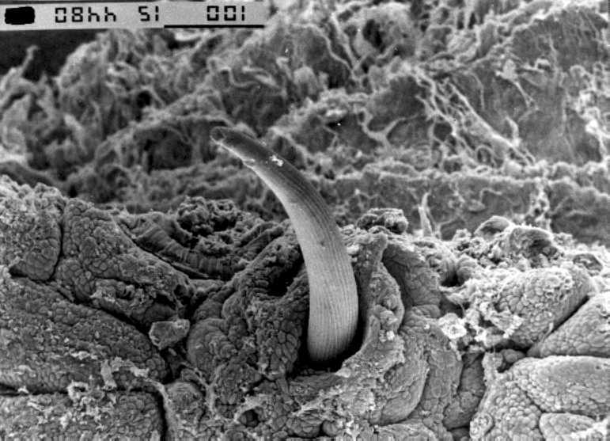
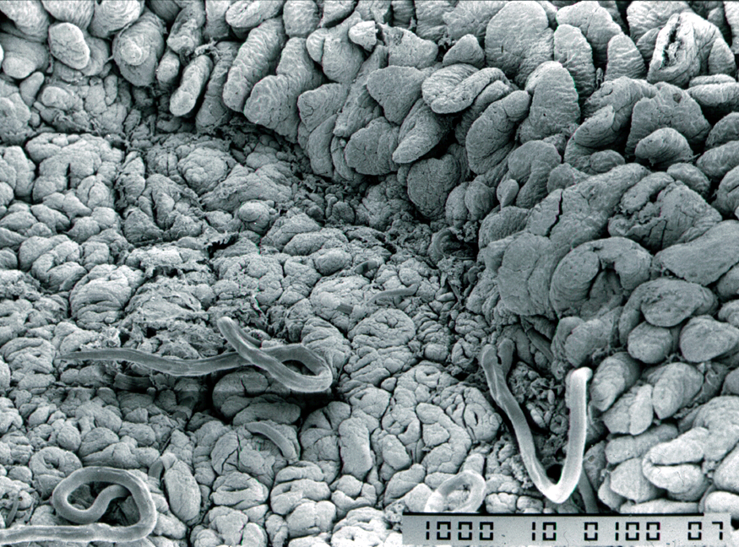
Worm damage and lamb growth
Worm infections reduce performance
  reduced food intake
  impaired food digestion
  protein leakage (needs replenishment)
  gut damage (needs repair)
Less nutrients left for growth
Disrupted stomach function
Gut damage in small intestine
Notes:
2

Slide 3
Discussion
Worm challenge is expensive
Regular worming improves lamb growth
Drenched, challenged lambs still lose out
Reduce challenge to improve productivity
Notes:
3

Slide 4
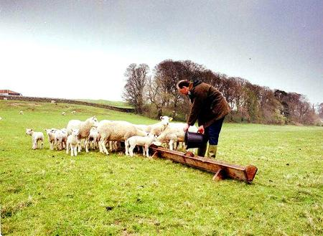
Ewe protein supplementation

Slide 5
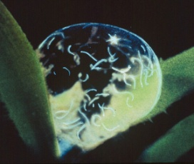
Ewe protein supplementation
Why to target ewes? Periparturient relaxation of immunity (PPRI)
  is sensitive to protein scarcity
  plays an important role in parasite epidemiology
A single lactating, underfed susceptible ewe could be a source of infection for many lambs
  Egg excretion over 14 days: 17,000,000 eggs
  If 25% successfully hatch: 4,300,000 larvae
  If 25% migrate to leaf area: 1,125,000 larvae
  Sub-clinical larvae exposure: 5,000 larvae/day
One ewe could infect 16 lambs for 14 days

Slide 6
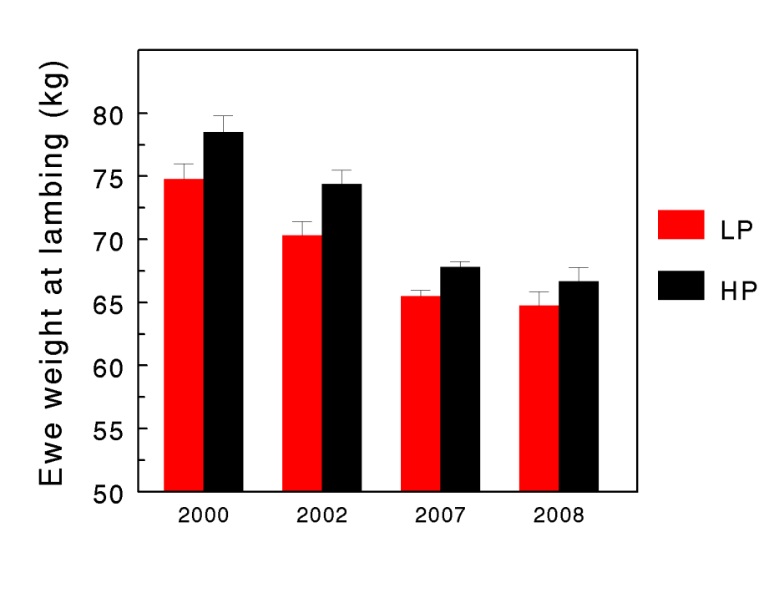
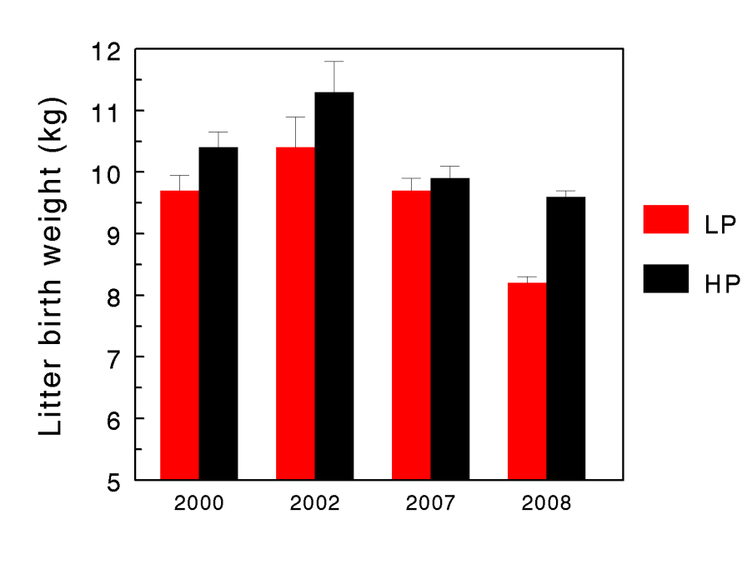
Discussion
Overcoming protein scarcity
Late pregnancy supplementation with high quality, by-pass protein
  Heavier lambs and ewes at lambing
  Reduced worm egg counts and worm burdens
Notes:
6

Slide 7
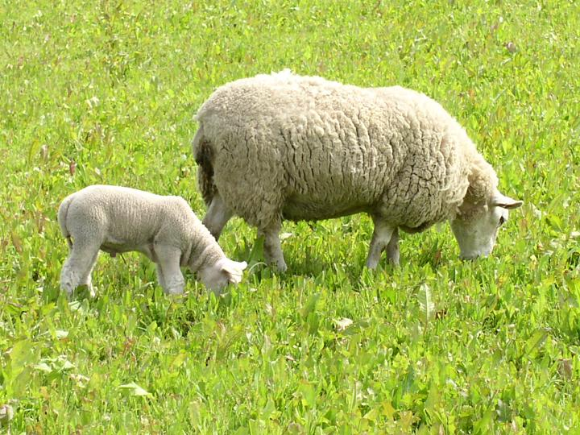
Bioactive forages

Slide 8

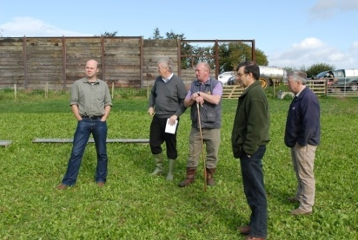
Anti-parasitic benefits of chicory
Multiple benefits:
  Fewer worms, faster growth
  Reduced drug input
  Reduced challenge

Slide 9
Farmer 2: Protein supplementation
2 weeks before official lambing date and 6 weeks of lambing as above but in addition ad lib Silage
Post Lambing n=10 ewes were supplemented with 100g organic soya per lamb (treated group). Control group stayed unsupplemented (n=10)

Slide 10
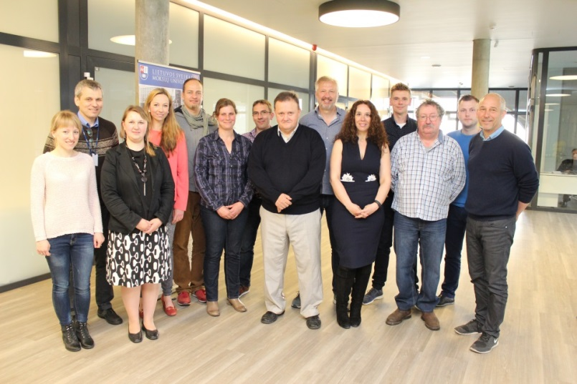
Acknowledgements
Funders
  EU (FP7 and CORE Organic)
  Scottish Government
  Defra
  BBSRC, DFID
  EBLEX, QMS, LMC, HCC
Colleagues, authors and co-authors
  SRUC / SAC: Alem Kidane, Ouranios Tzamaloukas, Panagiottis Sakkas, Jos Houdijk, Ilias Kyriazakis, Elly Navajas, Claire Morgan-Davies
  Moredun: Bob Coop, Frank Jackson, Dave Bartley, John Huntley, Fiona Kenyon, Dave McBean
  Bristol University: Geoff Nute, Ian Richardson
  Hawassa University: Ketema Tolossa, Adugna Tolera, Etana Debela
Notes:
The Langhill selection lines of dairy cattle have allowed us to dissect, in detail, many traits of biological importance in dairy cattle (production AND fitness traits)
However, the bringing in new tools and scientific disciplines have allowed us to explore these data in a new way, bringing about a rebirth in the value of the cows for research
Genomic data helping us explore the genetic differences between the lines (working to identify selection signature differences between the lines)
A more detailed understanding of potential differences in immune function between the lines and diets
Not only a relevant for new scientific exploration but also of value to the wider global dairy industry by pooling data from key international resource populations for more rare phenotypes such as dry matter intake
Not just a 2*2 experiment any more!

