Slide 1
WP4 – Knowledge platform and communication
Task 4.1 – Knowledge platform & project website - AU/ICROFS
Task 4.2 – Presentation of end-user material on platform – AU/ICROFS
Task 4.3 – maintaining the platform & moderating the discussion forum – IFOAM EU
Task 4.4 – Online training courses – IAMB
Task 4.5 – Public relations & communication – IFOAM EU
Presented by Ilse A. Rasmussen, AU/ICROFS

Slide 2
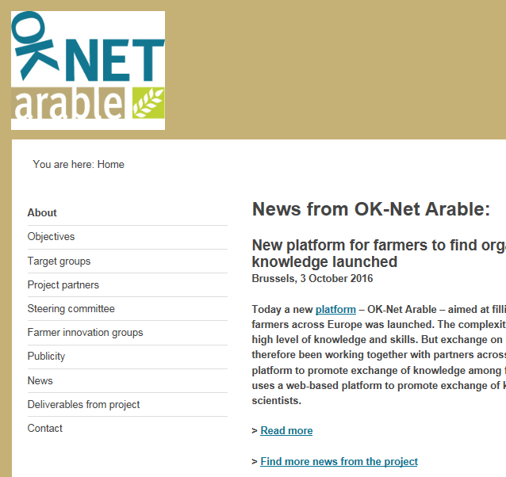
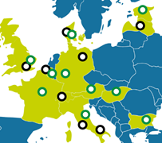
Task 4.1 – Knowledge platform & project website - AU/ICROFS
Project website was established May 2015
Information about the project
News
Map with project partners

Slide 3
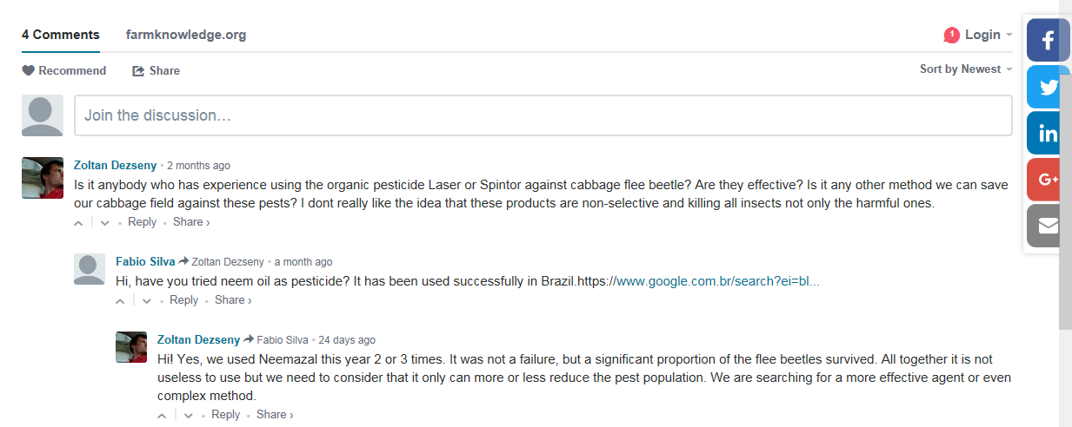
Task 4.1 – Knowledge platform & project website - AU/ICROFS
Survey on farmers’ use of social media (together with WP2 and WP3)
Report on potential discussion forums
”DISQUS” was chosen

Slide 4
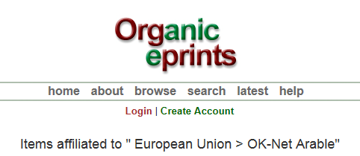
Task 4.1 – Knowledge platform & project website - AU/ICROFS
Organic eprints used for metadata about the tools

Slide 5
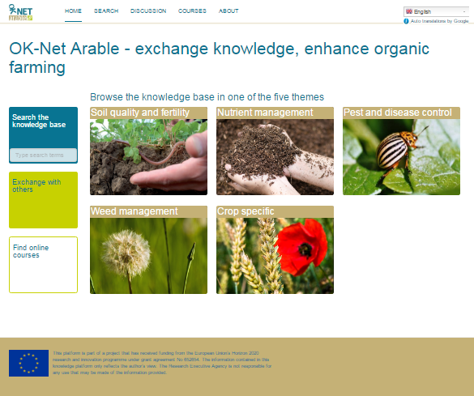
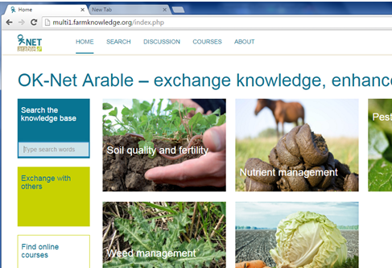
Task 4.1 – Knowledge platform & project website - AU/ICROFS
Knowledge platform betaversion online 1st March 2016
Consultation with partners for improvement
Public version launched 3rd October 2016

Slide 6
Task 4.1 – Knowledge platform & project website - AU/ICROFS
10 languages – Google translate + controlled translation
5 themes
Search function – simple or advanced version
31 tools
Discussion forum for each theme & tool
Rating of tools
”Tip-a-tool”

Slide 7
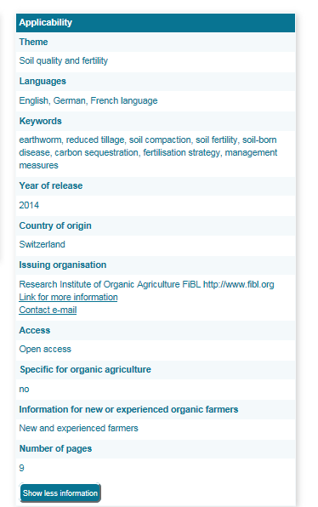
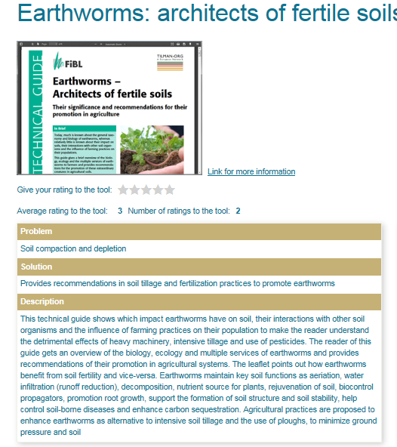
Task 4.2 – Presentation of end-user material on platform – AU/ICROFS
Nearly 200 tools collected (see 2.3 and 3.3)
– ranked by relevance, tool type, practicality of recommendations, language & translatability and geographical coverage
30 tools chosen
Tool information on knowledge platform

Slide 8
Next steps
T4.2 – Evaluation of new offer of end-user material at project meeting in M22-23
D4.2 – final report about end-user material M35
T4.3 – Maintaining and improving the knowledge platform
Moderating discussion forum
D4.4 – plan for continuation of knowledge platform M36
T4.4 – D4.2 online training courses M33
T4.5 – PR & communication – reported under WP1
D4.5 – Practice abstracts M36 – reported under WP1

Slide 9
Task 4.3 – maintaining the platform & moderating the discussion forum – IFOAM EU
No maintaining has been relevant yet.
The moderation of the discussion forum is the responsibility of IFOAM EU
Scientific partners & external experts will reply
Instruction videos are not necessary

Slide 10
Task 4.4 – Online training courses – IAMB
Task starts in February 2017

Slide 11
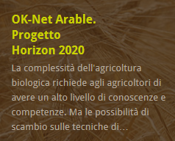
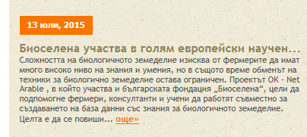
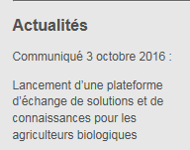
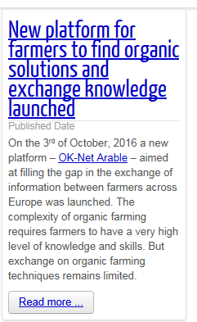
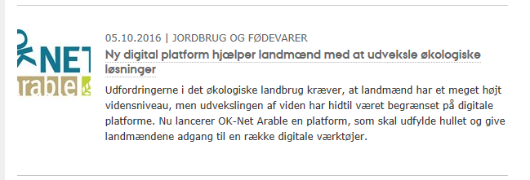
Task 4.5 – Public relations & communication – IFOAM EU
EU-level:
Project website, Website & newsletters of IFOAM EU & TPOrganics
Press releases
Presentation at international conferences & workshops
EXPO2015 Milan, BioFach
National/local level:
Partners’ communication channels
17 websites
55 articles on websites, in newsletters or farmers magazines
24 videos in three languages
Dissemination has reached
90,000 scientists
180,000 farmers & advisers
1400 policy makers
25,000 from civil society & general public

Slide 12
More information
Contact: Bram.Moeskops@ifoam-eu.org
Visit: www.ok-net-arable.eu
Visit http://farmknowledge.org/
OK-Net Arable has received funding from the European Union’s Horizon 2020 research and innovation programme under grant agreement No. 652654.
This communication only reflects the author’s view. The Research Executive Agency responsible for any use that may be made of the information provided.

