Slide 1
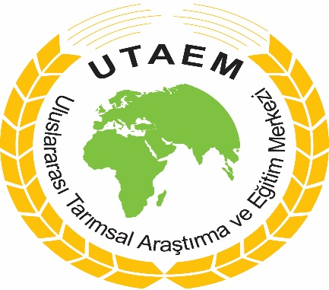
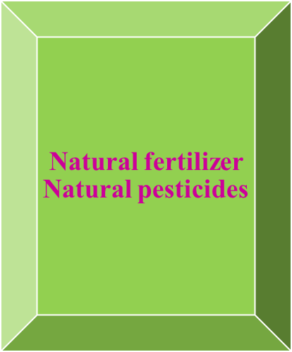
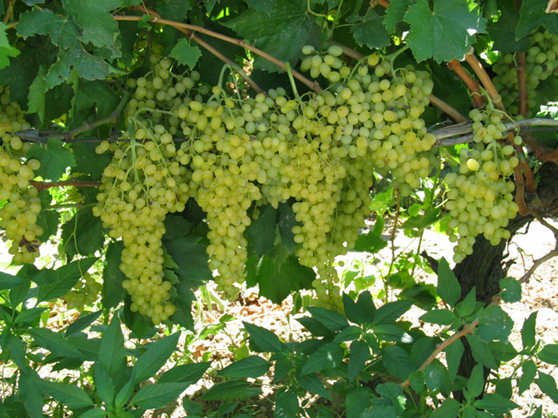
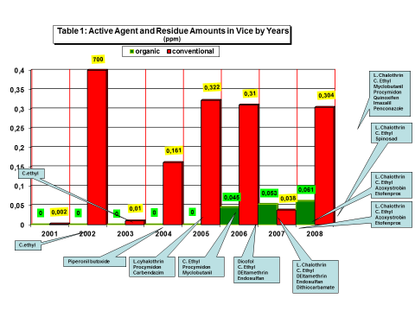
The Comparison of Pesticide Residues on Organic and Conventional Raisin Products in Aegean Region
Ülfet ERDAL¹ Mürşit DALÇAM² İhsan YASA³
1International Agricultural Research and Training Center Menemen-Izmir/Turkey
2Project Consultant Agr. Dipl. Engineer Researcher in the Agrochemical Business Izmir/Turkey
3Biology Department,Basic and Industrial Microbiology SectionScience Faculty,Ege University,Bornova-İzmir,/Turkey. ( ihsan.yasa@ege.edu.tr )
INTRODUCTION
Turkey is among the largest grapevine growing countries of the world with approximately 468,792 hectares of vineyard area and 4.01 million tons of grape production (5th in area; 6th in production). Grape production mainly consists of 52.80% table grapes, 36.40% raisins and 10.80% must-wine varieties (Anonymous, 2015). In the world, 311595 hectares of organic grapes are grown constituting 4.6 percent of the world’s grape growing area. Turkey is a major producer country of grapes growing in the world. Since 1985, Turkey producing and exporting organic raisins, is a world leader in the production of raisins. In Turkey, 8418 hectares grape are grown organically which constitutes 1.80 % of the total grape production area (Anonymous, 2016). Although grapes have been part of the human diet for centuries, pests and fungal diseases cause significant damage to the crops, thereby severely reducing their production (Reddy and Rao 2006).Fungal molds, and insects decrease the production of table grapes.
Deltamethrin belongs to alpha-cyano pyrethroid insecticides and is applied frequently at the beginning of the ripening season. It was initially believed to be the least toxic of all the pyrethroid-based insecticides. Recent research has shown it to be very toxic to non-target species (Anadon et al. 1996; Rehman et al. 2006). It is extremely toxic to fish with LC50s as low as 4.8 ug/l (Yildirim et al. 2006) and induces tumors in mice (Shukla et al. 2001).
MATERIAL AND METHOD
Experiments were carried out in 5 replicates completely randomized design through 9 years between 2000-2008. According to soil analysis results, certified fertilizer and green manure and ground pruned branches were applied as plant nutrition material in organic plots. On the other hand, chemical fertilizer were applied in conventional plots. Certified products and traps permitted in related organic regulations were used as plant protection material in organic plots. In conventional plots, standard pesticides were used.
CONCLUSION
According to research results, some small quantity of residues has been detected in a few case in the organic plots while high level residues have been dedected in the most cases in the conventional plots. The reason of chemical contamination in the organic plots is needed to be investigated and certification process should be carried out more strictly.
FINDINGS AND DISCUSSION
REFERECENCES
Anonymous 2015. FAO Statistical Yearbook 2013 World Food and Agriculture. http://www.fao.org/docrep/018/i3107e/i3107e.PDF.
Anonymous 2016. FIBLE and IFOAM Organic International The World of Agriculture. Istatistics and Emerging Trens. https://shop.fibl.org/fileadmin/documents/shop/1698-organic-world-2016.pdf.
Anadon, A., Martinez-Larranaga, M. R., Fernandez-Crus, M. L., Diaz, M. J., Fernandez, M. C., & Martinez, M. A. (1996). Toxicokinetics of deltamethrin and its 4’-HO-metabolite in the rat. Toxicology and Applied Pharmacology, 141, 8–16.
Leistra, M., Zweers, A. J., Warinton, A. J., Crum, S., Hand, L. H., Beltman, W., et al. (2003). Fate of the insecticide lambda-cyhalothrin in ditch enclosures differing in vegetation density. Pest Management Science, 60, 75–84. doi:10.1002/ps.780.
Rehman, H., Ali, M., Atif, F., Kaur, M., Bhatia, K., & Raisuddin, S. (2006). The modulatory effect of detlamethrin on antioxidants in mice. Clinica Chimica Acta, 369, 61–65. doi:10.1016/j.cca.2006.01.010.
Shukla, Y., Arora, A., & Singh, A. (2001). Tumourigenic studies on deltamethrin in Swiss albino mice. Toxicology,
163, 1–9. doi:10.1016/S0300-483X(00)00416-9.
Sucahyo, D., van Straalen, N. M., Krave, A., & van Gestel, C. (2008). Acute toxicity of pesticides t th tropical shrimp Caridina laevis. Ecotoxicology and Environmental Safety, 69, 421–427.
Yildirim, M. Z., Benli, A., Ozkul, A., Erkoc, F., & Kocak, O. (2006). Acute toxicit, behavioral changes, and histopathological effects of deltamethrin on tissues (gills, livers, brain, spleen, kidney, muscle, skin) of nile tilapia (Oreochromis niloticus L.) fingerlings. Environmental Toxicology, 21, 614–620.
Acknowledgments: This study is supported by Ministry of Food Agriculture and Livestock and General Directorate of Agricultural Research and Policies
In this study, active agents in raisins were determined and their residue amounts were stated as ppm (mg/kg) by running residue analyses on both conventional and organic raisins cultivated between 2001 - 2008. You can find the results of residue analyses run on raisins between 2001 – 2008 on Table 1. According to the results of residue analyses in experimental plots in Salihli, it is quite shocking to find that chlorpyrifos-ethyl active agent residue was much higher than minimum residue limit (MRL), 0,5 ppm, in 2002 conventional batch. Other than 2002 conventional batch, residue amounts of all the active agents were lower than the MRL levels (ftp://ftp.fao.org/codex/cdac15/la15_09e.pdf ). 2006, 2007 and 2008 organic batches were chemically contaminated and no longer organic. This contamination is expected to be caused by an external source. It is considered as a clue that the neighboring field was converted into conventional agriculture from organic agriculture. This idea is also supported by the fact that there were other chemical active agents in these parcels, even though only clorpyrifos-ethly against grapevine moth (lobesia botrana) and lambda cyhalothrin against powdery mildew (uncinula necator) were applied. Although pesticides can significantly reduce grape spoilage, overuse can pose long-term environmental problems. Field application rates of lambda-cyhalothrin have been reported in the range of 0.005 to 0.015 kg/ha at the beginning of the season with repeat applications during the summer at 2-week intervals (Leistra et al. 2003). Chlorpyrifos is an organophosphate insecticide used against grapevine moths. It is one of the most toxic organophosphate pesticides with a 24-h LC50 ranging from 0.05 to 8.2 ug/L (Sucahyo et al. 2008).

