Slide 1
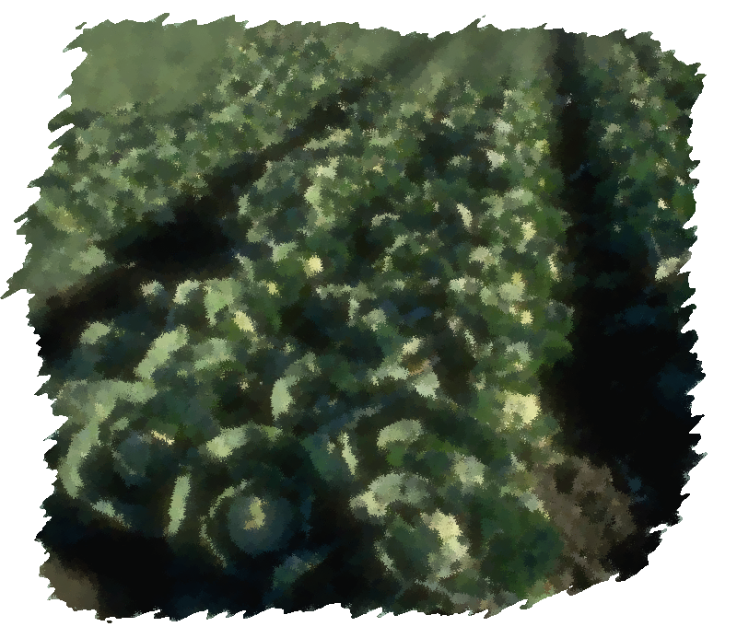
Results and lessons learnt from field vegetables activity
cabbage
Use your mouse to see tooltips or to link to more information

Slide 2
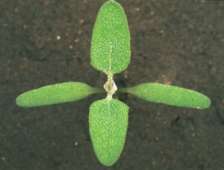
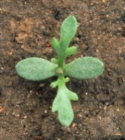
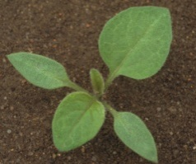
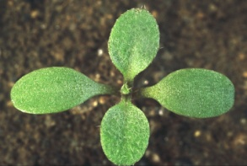
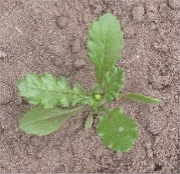
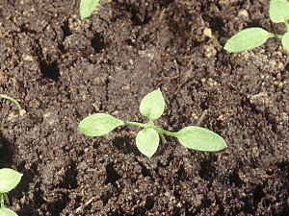
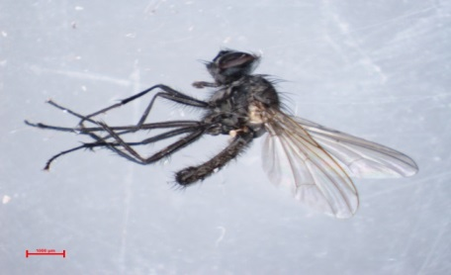
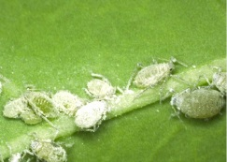
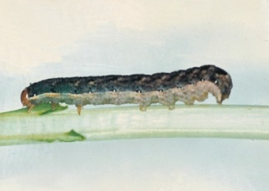
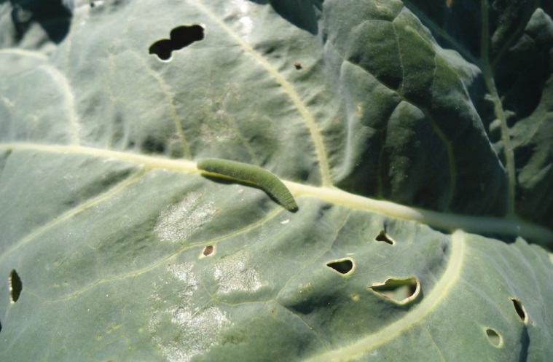
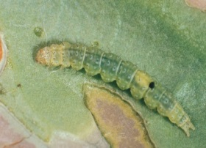
Background
Cabbages is one of the major field vegetable cultivated in Europe
On-farm and on-station experiments have been conducted on the main pests and pathogens in Europe.
Weeds
Insects

Slide 3
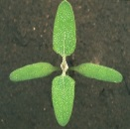
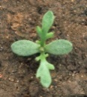

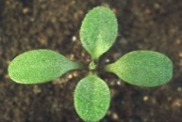
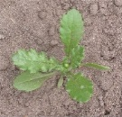
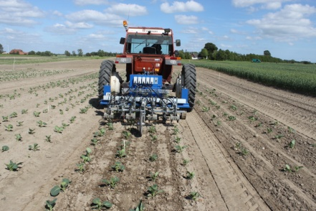
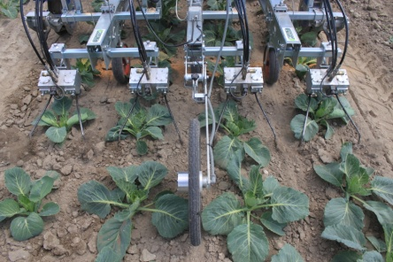

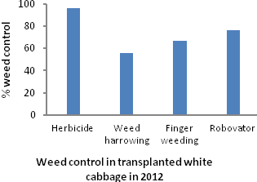
Weeds management
Use of Robovator in white cabbage
Unfortunately, there were not enough weeds to estimate the weed control effects in 2013

Slide 4
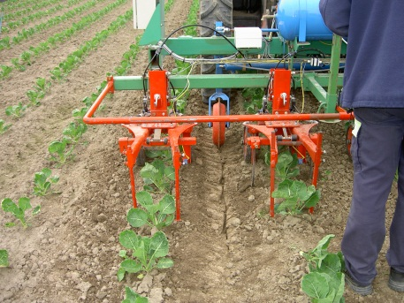

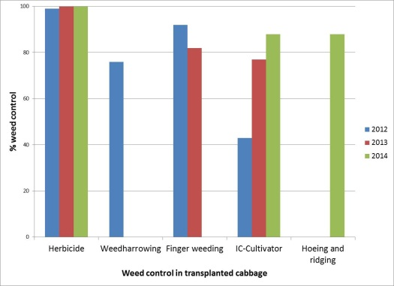
Weeds management
Use of IC-cultivator in brussels sprout
Main results
Mechanical weed control technically is very well possible in cabbage, with conventional equipment.
Intelligent intra-row weeding is not particularly needed for a good result, which means such equipment is not cost-effective for cabbage growers.
Hoeing with an in-row measure like finger weeders or ridging will do the job.
No yield effects were found in the experiments.

Slide 5
Weeds management
Sustainability
Country | System | Sustainability
 |  | Economic | Environmental | Social | Overall
 | CON | H | M | M | M
 | ADV | M | M | M | M
 | INN | L | H | H | M
 | CON | H | VL | L
 | ADV | M | M | H
 | INN
Results of DEXiPM calculations experiments.
Comparison of conventional (CON), advanced (ADV), and innovative (INN)
weed control (VL = very low, L = low, M = medium, H = high, VH = very high).
Labour demand is an important factor as farm size increases, and therefore the perceived weather risk of non-chemical measures

Slide 6
Weeds management
Main conclusions
Transplants of white cabbage need to be of a good quality for intelligent weeding to work properly.
The stems of cabbage transplants are often bended which means that the hoe blades of the robotic weeder need to keep a safe distance from the stems, implying a less than optimal usage of the equipment.
The size of this untreated zone in close proximity to the transplants determines the demand for manual weeding of residual weeds. It is essential to minimize that zone to lower the overall costs for weed control.
The purchase costs for intelligent weeders are still high and need to be reduced in the future.
The non-intelligent mechanical weeders can be useful but training and guidance are still required for successful employment.

Slide 7
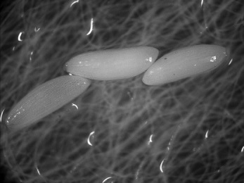

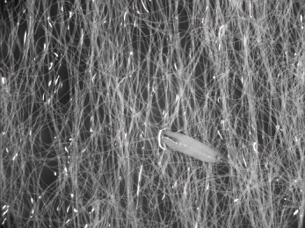

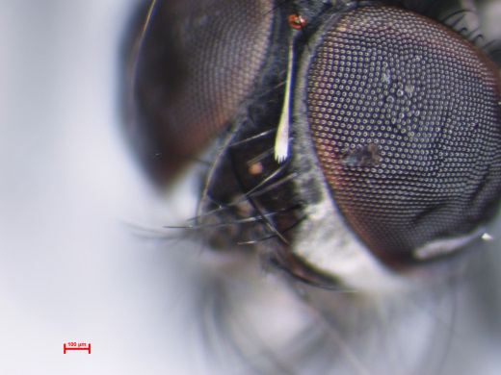
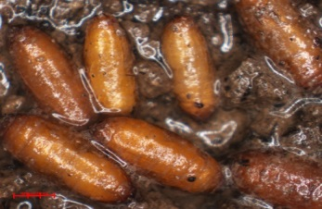
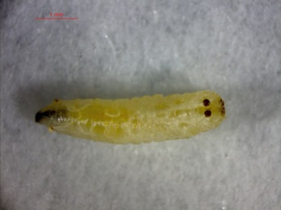
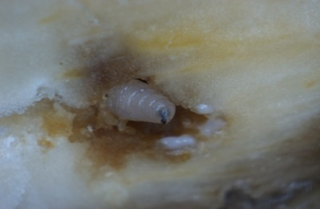
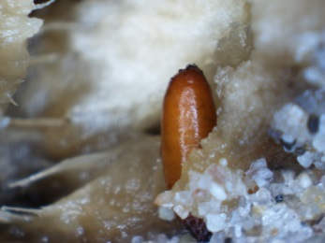
Cabbage root fly
Delia radicum L. life cycle

Slide 8
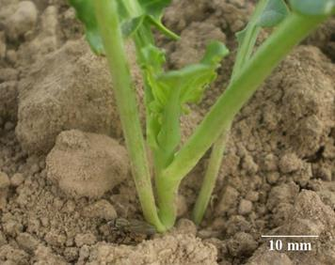
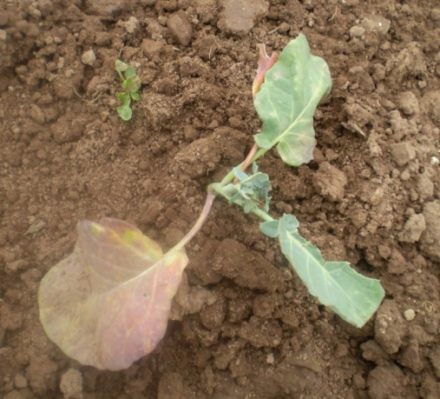
Cabbage root fly Damages
Cabbage root fly oviposition
Cabbage root fly damage to broccoli.

Slide 9

Cabbage root fly
The use of biological insecticide (spinosad) resulted in a pest reduction equal to one of broad spectrum insecticides (thiametoxam).
Some broad spectrum insecticides (lambda-cychalotrin) resulted in an increase of pest pressure, probably due to elimination of pest’s natural enemies.
Treatments with PERLKA (lime nitrogen), Naturalis (entomopathogenic fungus Beauveria bassiana) or straw did not achieve sufficient pest control.

Slide 10

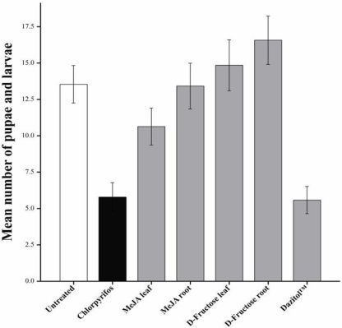
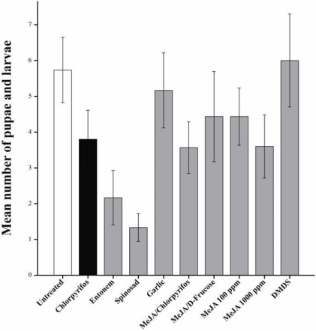
Cabbage root fly
Results from on-farm field experiment showed that Chlorpyrifos (Dursban WG) significantly reduced cabbage root fly feeding damage and the number of pupae/larvae recovered compared with untreated controls.
MeJA leaf and D-Fructose leaf treatments marginally, but not significantly, reduced larval damage compared with untreated plants. Only MeJA leaf treated plants significantly reduced the number of pupae/larvae, but numbers were still significantly higher than plants treated with Chlorpyrifos.
Numbers of cabbage root fly pupae/larvae recovered at the end of field experiment in 2012 were lower than 2011. The lack of significant differences between treated and control plants for cabbage root fly larval root damage potentially reflected the low number of eggs and consequently larvae present.
Despite this, results demonstrated that Entonem (Steinernema feltiae Filipjev), Spinosad (Tracer®), and a combination of the elicitor MeJA and reduced rate Chlorpyrifos showed some efficacy for controlling cabbage root fly larvae.
At the concentrations tested, Garlic, MeJA on its own, DMDS (dimethyl disulfide), D-Fructose on its own and in combination, and Dazitol™ treatments were either inconsistent or reduced yield (phytotoxic) in comparison to plants treated with Chlorpyrifos and untreated control plants.

Slide 11

Cabbage root fly
The application of spinosad and the chemical test product (not yet registered) resulted in a reduction of pupae and larvae by 50 %. Compared to the control nematodes had only slight pupae reducing properties, whereas with nitrogen lime even more pupae and larvae were found.
control spinosad chem. test prod nematodes nitrogen lime

Slide 12
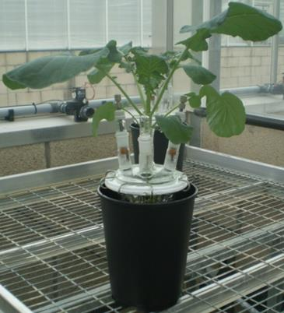
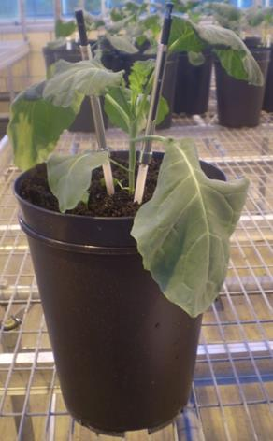
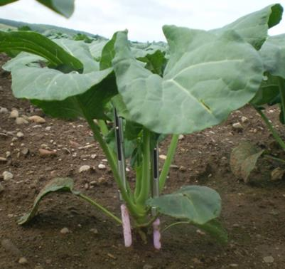
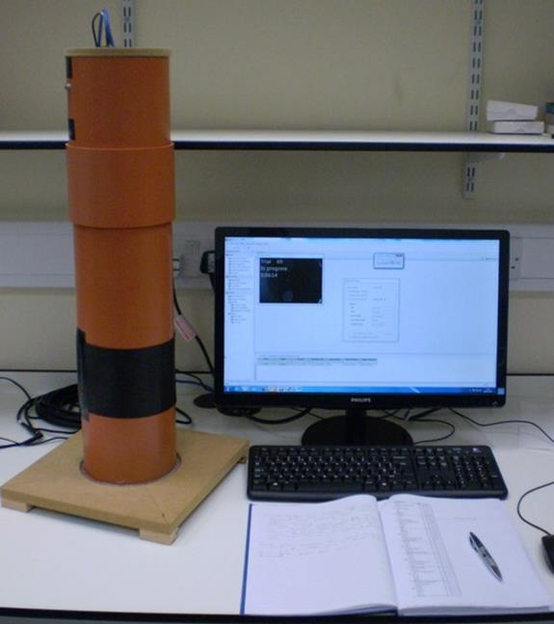
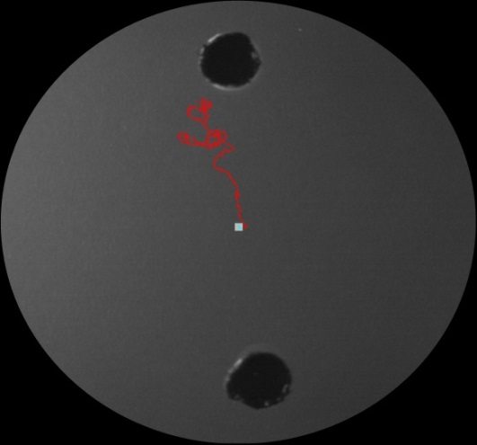


Cabbage root fly
Innovative methods
Root volatiles analysis revealed marked differences in the emission rates of volatile compounds detected before and after mechanical and cabbage root fly larval feeding damage.
EthoVision® bioassay results revealed that newly hatched cabbage root fly larvae were significantly attracted to host plant root volatiles. A major volatile constituent of broccoli roots, DMDS, was attractive to larvae, but toxic at the highest dose tested

Slide 13
Cabbage root fly main conclusions
Current recommendation to farmers is the drench of plants with spinosad shortly before planting.
Despite the positive results, in some countries (Slovenia) this substance is not registered for cabbage root fly control.
Therefore action is needed to facilitate the registration process to enable such pest control.
Additionally, more research is needed to find alternative products for cabbage root fly control, as some reports exist that spinosad can harm non-target organisms.

Slide 14
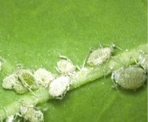
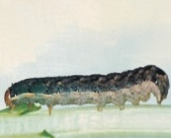


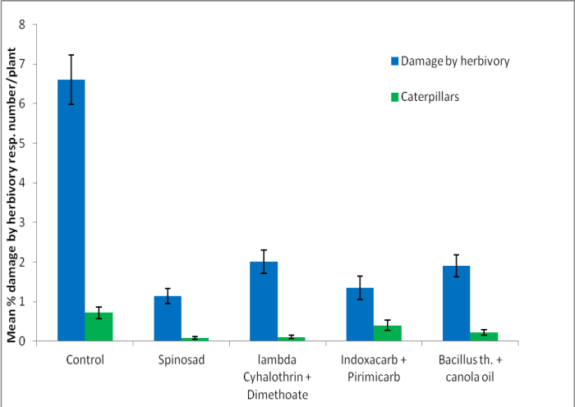
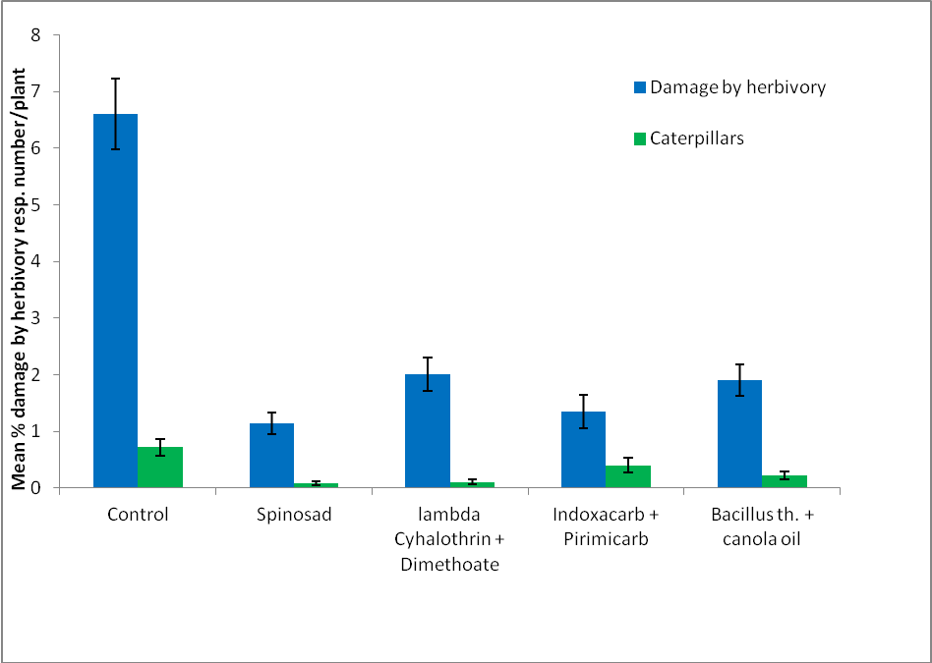
Aphids and caterpillars
A
Insect pest infestation was very low in the last years.
At harvest all plant protection products reduced the number of caterpillars as well as damage by herbivory considerably.
B B B B
a b b a b
In 2012 numbers of aphids at harvest were lowest in the untreated control.
Higher numbers of aphids and parasitized aphids were found on plants treated with plant protection products and especially when spinosad was used against caterpillars.
This result could indicate that insecticides may harm aphid predating insects.
However this finding needs to be confirmed.
B
A A A A
a b a a a

Slide 15

Environmental sustainability
Acute risk
Conventional
Advanced
During on-farm trials in 2014 insecticides were sprayed 10 times on the
conventional part of the field compared to five applications on the field sprayed only when thresholds were exceeded.
On conventional fields two more treatments were applied against caterpillars, one against aphids and two against thrips.
Data about cost-benefit-efficacy are not yet available since cabbage heads are still in the cold warehouse.

Slide 16
Environmental sustainability
Chronic risk
Conventional
Advanced

Slide 17
Aphids and caterpillars main conclusions
Spraying plant protection products after control thresholds are exceeded is a very good option for reducing the amount of insecticides.
Biological and selective insecticides performed as well as broad spectrum insecticides.
However an adaption of thresholds is needed to the respective farm due to occurrence of insect pests, environmental conditions, production goals and market demands.
Furthermore the establishment of control thresholds for all pests of one crop is important.

Slide 18
For more information
Download the following documents
the BOOKLET
the IPM guidelines
Go to the field visits

