Slide 1
WP 2
Innovative IPM solutions
for winter wheat-based rotations
Modification/change of sowing date
Members of WP2 PURE project
February, 2015

Slide 2
What are the issues?
Agronomical issues
development of cultivars with resistance to plant pathogens and pests. Cultivars with good competition too weeds to decrease the need for pesticides
Health issues
Less spraying means less exposure to pesticides by farmers
Less risk for pesticide residues in feed, food and drinking water.
Environmental issues
Less risk for negative impacts from pesticides on the environment - water, soil and air (many references)
Economic issues
Alternative methods should be applied if they can minimize problems with plant pathogens, weeds and pest without causing a significant yield decrease

Slide 3
What are the issues?
Regulatory issues
- Directive eau cadre framework in France (2015)
- Ecophyto 2018 plan
- Water Framework Directive (applies for all EU Member States)
- National Action Plan (Germany)
- Early sowing is promoted to minimize risk of Nitrogen leaching, early sowing (before 7th Sept) can replace area with intercropping (in Denmark)
GOAL
We have to identify the possibilities for reducing the dependency on pesticides in sustainable cropping systems
Notes:
Put different examples in diff countries

Slide 4
PURE project (WP2) Innovative IPM cropping systems designed for winter wheat-based rotations
Trials locations in Europe where IPM cropping systems
were assessed, Pure project (WP2)
Dundee (UK)
Slagelse (D)
Dahnsdorf (G) Poznan (P)
Grignon (F)
Boigneville (F)

Slide 5
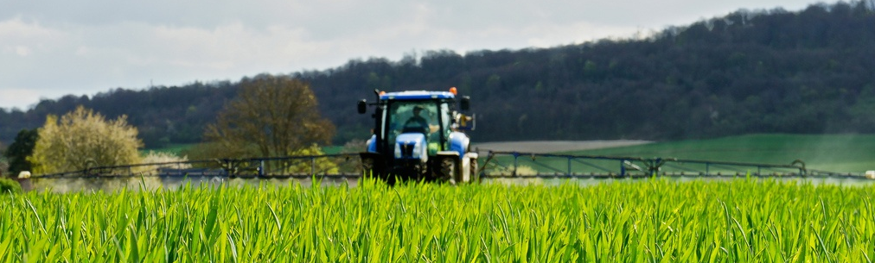
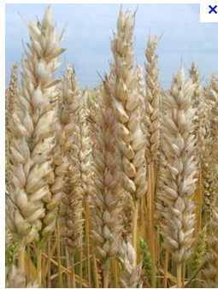
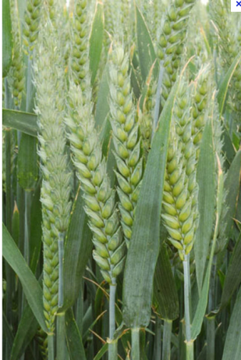
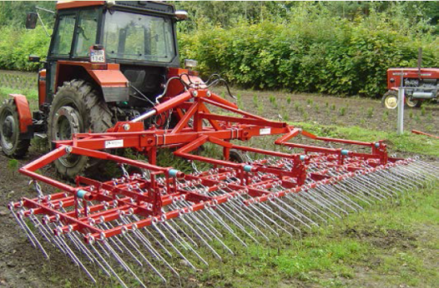
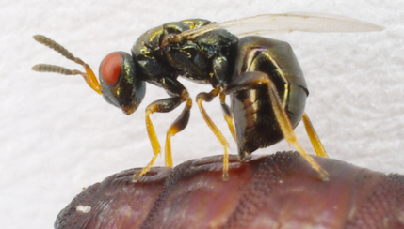
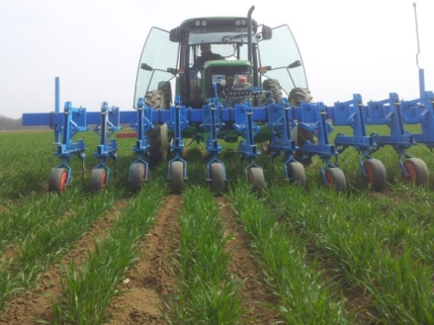
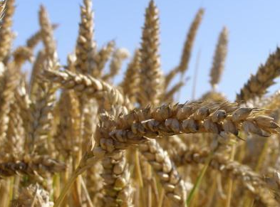
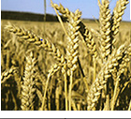
Different controls against plant pests used in the innovative IPM cropping systems designed for winter wheat-based rotations
Chemical control
pesticides sprayings
Cultural methods:
modification
of sowing date
Plant PESTS
Genetic control
Different winter wheat varieties
Physical control
Mechanical weeding
Biological control
Trichogramma against
Ostrinia nubilalis on maize

Slide 6
Strategies to reduce plant pests
Action plan on initial stock
- rotation modifications, tillage practices, …
Pathogens avoidance
fostering time lag between pathogens contamination period and crop sensitivity : to delay or to bring forward sowing date
Impact mitigation over crop growth
Increase crop competitiveness (as sowing intercropping, resistance varieties,…)
Remedial actions
When practices are unsuccessful: use mechanical weeding or herbicide
Notes:
Put photos
Tillage
Ras
Intercropping photos (cereal pea)
Hoe or pesticide spreader

Slide 7
Modification of sowing date in the different innovative IPM cropping systems (cs) in some WP2 trials to reduce pest impacts
Slagelse (D)
IPM cs1 IPM cs2
WOSR WOSR
WW WW
SB SO
Dahnsdorf (G)
IPM cs1 IPM cs2
M M
WW WW
WB WB
L
L
L
L
Grignon (F)
IPM cs1 IPM cs2
WFB SFB
WW WW
WORS HE
WW TR
SB M
WW
Poznan (P)
IPM cs1 IPM cs2
WOSR WOSR
WW WW
SB SB
L
L
E
L
E = earlier than current practice
L = later than current practice

Slide 8
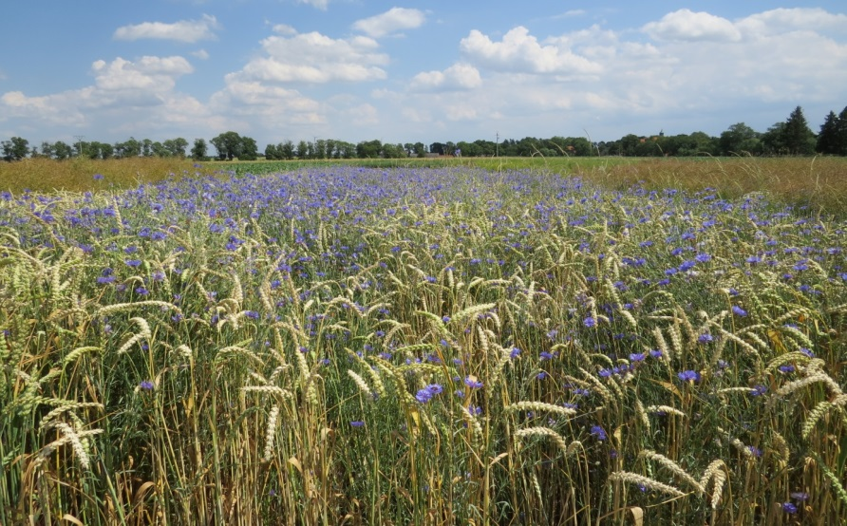
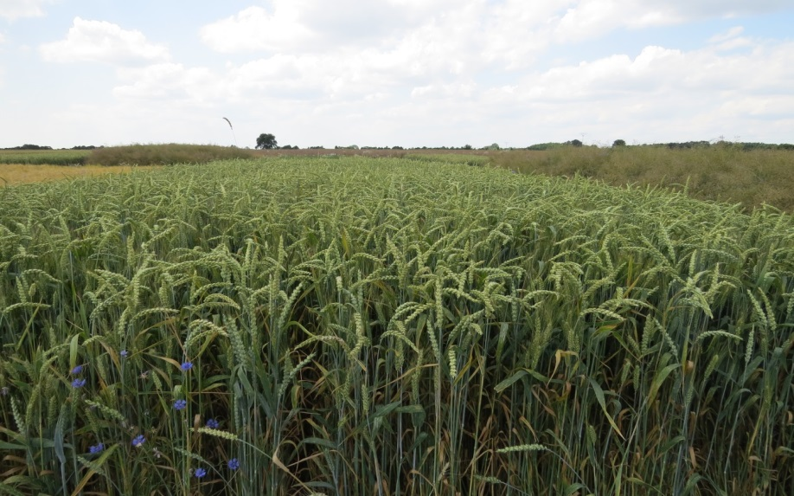
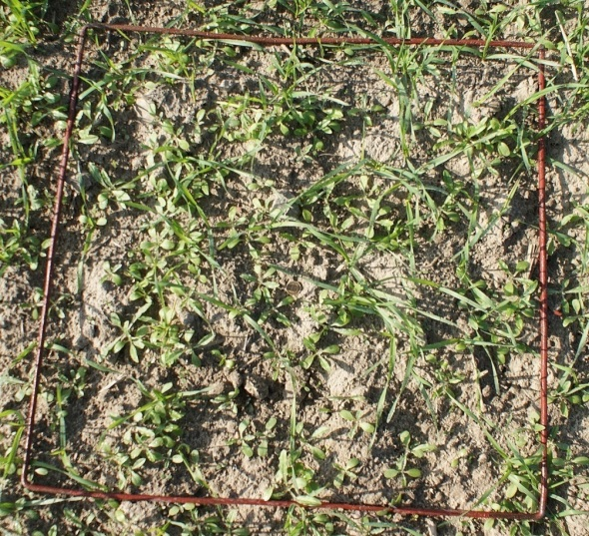
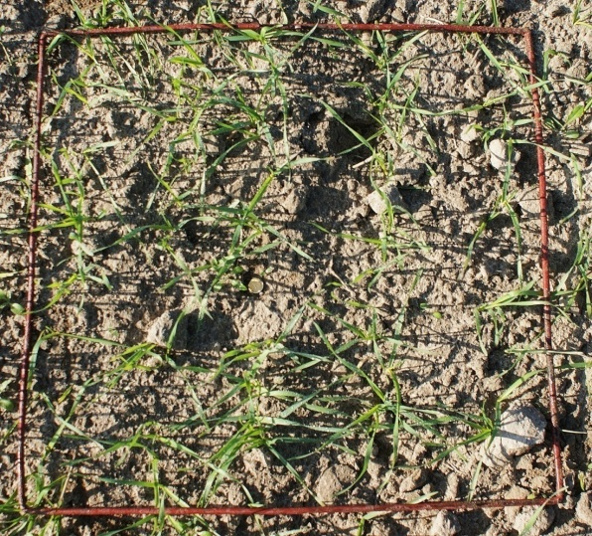
Winter wheat: different sowing date Case in Poznan (Poland, 2014)
Before harvest , July 2014
Beginning of spring, March 2014
Current sowing date Delayed sowing date more weed germination in autumn lower weed infestation

Slide 9
Impacts of sowing date modification
On diseases
reduce potential disease cycle number with late sowing,
reduce sensitive period of crop with late sowing in winter or early sowing in spring,
increase robustness of plant over contamination period with early sowing of winter oilseed rape.
On weeds
Enhance crop growth competitiveness with early sowing for crops which have high growth before weed emergence,
Avoiding weeds which have same emergence date than crop sowing with late sowing which allowed false seed-bed
On insects
To avoid peak period of attacks with late sowing for winter cereals (against aphids) with early sowing for winter oilseed rape (against psylliodes chrysocephala)
Notes:
Put picture of winter oilseed rape crop in autumn

Slide 10
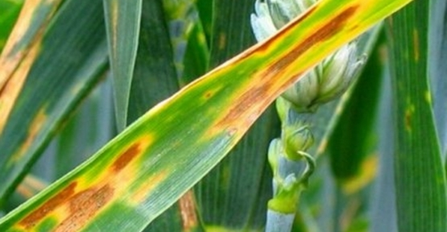
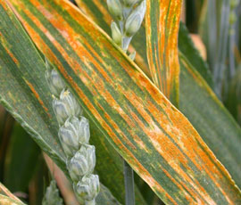
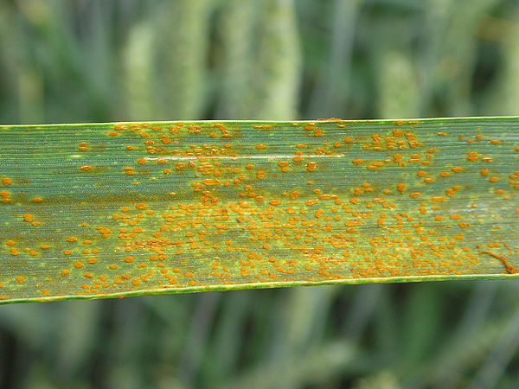
Most important diseases in winter wheat in the PURE WP2 trials (2011-2013)
Septoria Yellow rust Brown rust
Mycosphaerella graminicola Puccinia striiformis Puccinia recondite
Disease impacts which could be decreased by modifying sowing date

Slide 11
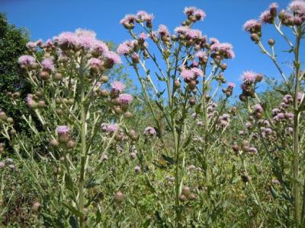
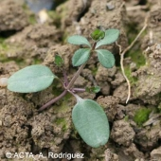
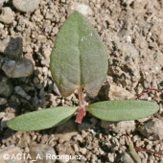
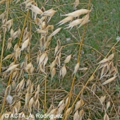
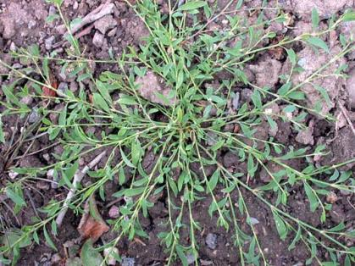
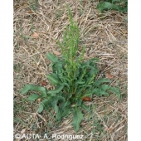
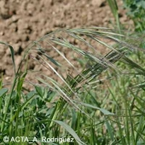
Main Weeds in the PURE WP2 trials in France
Fallopia convolvulus
Cirsium arvense
Galium aparine
Lolium perenne
Avena fatua - sterilis
Polygonum aviculare
Chenopodium album
Rumex crispus
Bromus sterilis

Slide 12
Positive and negative effects from none chemical methods, including sowing date, in winter wheat

Slide 13
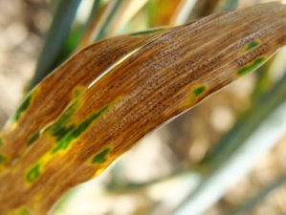
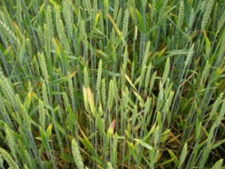
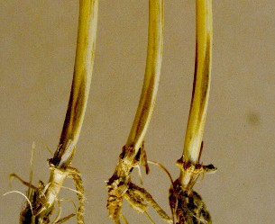
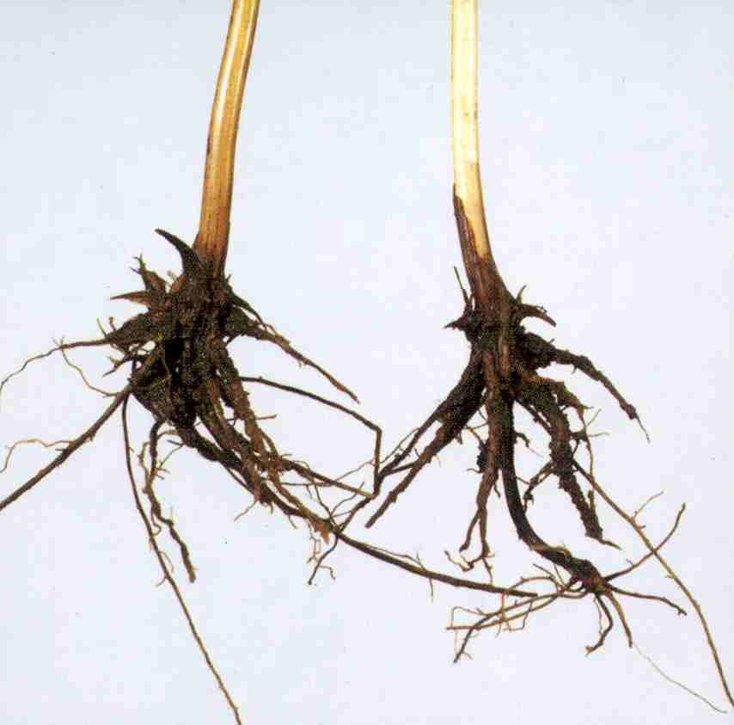
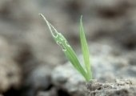
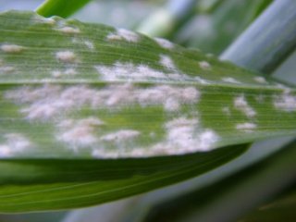
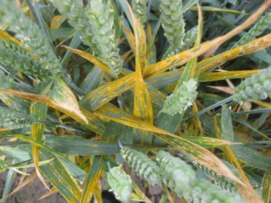
Dilemmas with early or late sowing in wheat in Denmark
Crops are not just attacked by single pest. Changes in sowing dates can increase or decrease a problem
Early sowing increase problems like:
Take all, eyespot
Septoria
BYDV (aphid transmitted)
Snowmould
Late sowing increase:
Mildew
Yellow rust
Risk of slugsattack

Slide 14
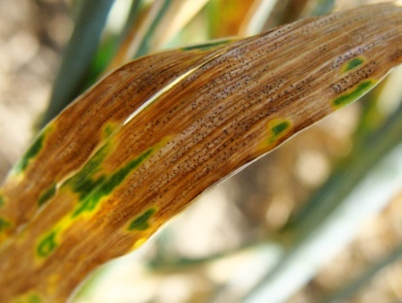
Link between sowing dates and attack of septoria (3513 UK fields)
Gladder et al., 2001
Gladder et al 2001

Slide 15
Winter wheat take all. Effect of sowing date
Data from Rothamsted

Slide 16
Sowing times effect on septoria and yield
Sowing date | % attack in June | % attack in Jully | Yield (dt/ha)
1 September | 2.4 | 4.1a | 80.7
20 September | 1.8 | 2.9b | 80.5
10 October | 1.2 | 2.7b | 55.5
4 trials AU 1993-94

Slide 17
Results from innovative IPM cropping systems assessed in the WP2 trials
➔No result specifically linked to a modification of sowing date because to be efficient this cultural practice has to be combined with other ones as follows

Slide 18
➔To be efficient, strategies and practices have to be combined (1/3)
Classification of combined practices against diseases
Main practices
Rotation
Variety choice
Variety or species mixtures
Second practices
Seed quality
Tillage management
Residue management
Volunteers management
Date and density of sowing
Nitrogen availability management
Additional practices
Biologic control
Chemical control

Slide 19
➔To be efficient, strategies and practices have to be combined (2/3)
Classification of combined practices against weeds
Mains practices
Rotation
Tillage management
Date of sowing
Second practices
Seed quality
False seed-bed
density of sowing
Nitrogen availability management
Variety choice
Additional practices
Biologic control
Chemical control

Slide 20
➔To be efficient, strategies and practices have to be combined (3/3)
Classification of combined practices against pests
Mains practices
Rotation
Second practices
Tillage management
Residue management
Volunteers management
Date of sowing
Nitrogen availability management
Variety or species mixtures
Additional practices
Biologic control
Chemical control

Slide 21
Examples of cultural practices against plant pathogens, weeds and pests
For winter wheat against diseases
Resistant variety or mixture of varieties + late sowing date + decrease of sowing density + decrease of nitrogen fertilization to reduce disease impacts
For winter oilseed rape against diseases and insects
Resistant variety + early sowing date + decrease of sowing density + decrease of nitrogen fertilization to reduce disease (phoma lingam) or insect impacts
For maize or sunflower against weeds
False seed-bed + late sowing date + Competitive variety choice + mechanical weeding

Slide 22
Conclusion
Modification/change of sowing date could be a efficient alternative practice to reduce impact from different pests,
To be efficient, this practice need to be combined with different others practices,
To reduce pest impacts, it is necessary to act as early as possible to decrease theirs pools

