Slide 1
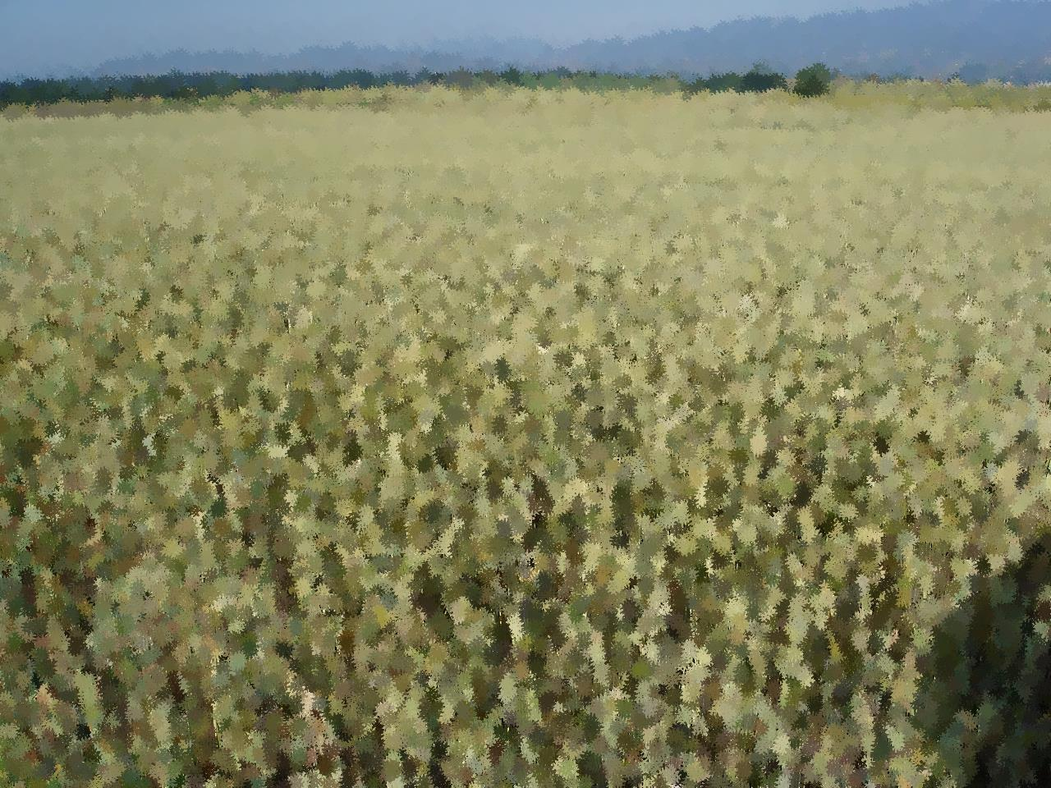
Results and lessons learnt from wheat-based cropping system activity
Use your mouse to read tooltips or to link to more information

Slide 2
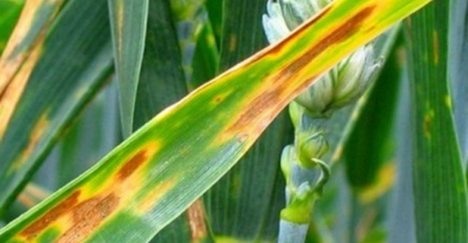
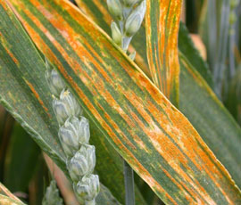
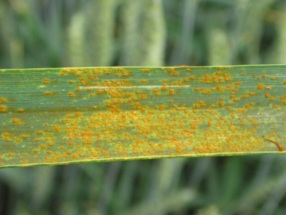
Background
Wheat-based is one of the major annual cropping system in Europe
On-farm and on-station experiments have been conducted on the main pests and pathogens in Europe.
Weeds → annual flora :
  Apera spica-venti, Lolium multiflorum, avena fatua
  Galium aparine, Centaurus cyanum, Matricaria sp.
Diseases:

Slide 3
Location of on-station experiments

Slide 4
IPM strategies
To reduce the dependence on herbicides and fungicides.
IPM 1 = more diverse crop rotation + more use of preventive cultural practices + mechanical weed control measures and disease resistant varieties
IPM 2 = further crop diversification + cover crops + more use of forecasting models and decision support system + innovative IPM tools

Slide 5
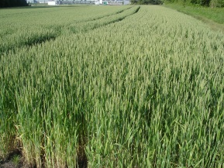
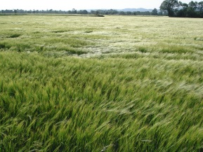
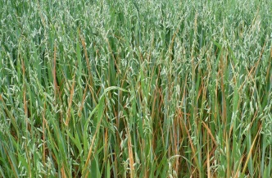
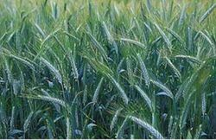







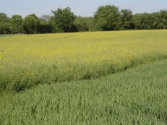
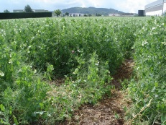
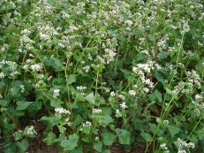
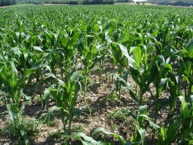
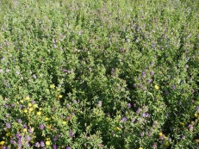
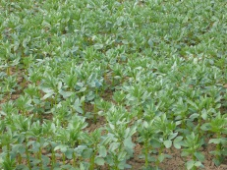
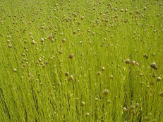
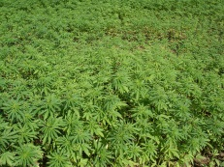
Crop rotations

Slide 6
Wheat yields in 6 on-station experiments
IPM1
IPM2

Slide 7

Treatment Frequency Index (TFI)
Treatment Frequency Index (TFI)

Slide 8
DEXiPM analyses of the Arvalis on-station experiment
CP
IPM1
IPM2

Slide 9




Results of the SYNOPS analyses (1 m distance to water courses was assumed) are available for three of the six on-station experiments
 | Risk aquatic organism |  | Risk groundwater
 | Acute | Chronic | Single substance | All substances
Germany | CP>IPM1>IPM2 | CP>IPM1>IPM2 | CP>IPM1>IPM2 | CP>IPM1>IPM2
Denmark | CP>IPM1>IPM2 | CP>IPM1>IPM2 | CP>IPM1>IPM2 | CP>IPM1>IPM2
France (Arvalis) | IPM1>CP | CP>IPM1 | CP>IPM1 | CP>IPM1
France (INRA) | CP>IPM1 | CP>IPM1 | CP=IPM1 | CP=IPM1

Slide 10
Cost benefit analyses

Slide 11
Crop diversity
Four of the six on-station trials have only run for 3 years and no conclusions concerning the impact of crop diversity can be drawn
The two French trials have run for longer and have high diversity of crops but it is difficult to assess the effect of crop diversity because it is confounded by the effects of the other cultural differences between the CP, IPM1 and IPM2 systems.

Slide 12
Variety mixtures
The potential benefits of variety mixtures are illustrated very clearly looking at the assessments of septoria in the Danish experiment
 |  | % attack of septoria on flag leaves
 |  | 2012 | 2013 | 2014 | Average
CP | Control | 10.0 | 30.0 | 53.0 | 31.0
CP | Treated | 0.7 | 3.0 | 21.0 | 8.2
IPM1 | Control | 0.1 | 32.0 | 21.0 | 17.7
IPM1 | Treated | 0 | 3.0 | 2.2 | 2.6
IPM2 | Control | 0.5 | 0.7 | 13.0 | 4.7
IPM2 | Treated | 0.5^{no treatment} | 0 | 7.3 | 3.9

Slide 13

Variety mixtures
In all three growing seasons the level of attack in the control plots was lower in IPM2 than in CP (most widely grown variety) and IPM1 (a partly resistant variety) allowing a for reduced input of fungicides.

Slide 14


Weed harrowing
Weed harrowing with flex tine harrows has shown promise for mechanical weed control in spring sown cereals. In PURE the harrow was used in oat.
The results revealed once again very variable effects

Slide 15

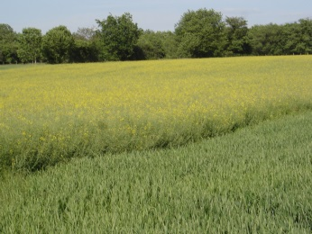
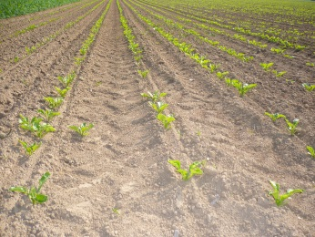
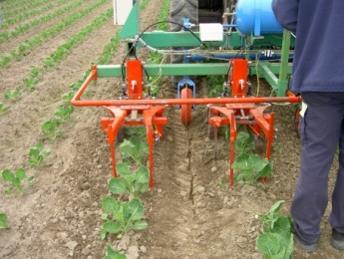
Inter-row cultivation
Inter-row cultivation was practiced in winter oilseed rape on several locations. Instead of sowing the crop at the standard 12 cm row distance it was sown at 50 cm row distance.
Inter-row cultivation can also be done in combination with band spraying

Slide 16
Conclusion
To omit the use of pesticides can result in pronounced yield losses in winter wheat
This is also highlighted by the fact that the yield losses in IPM1 were small compared to the very significant reductions in pesticide use
Exceptions:
  Inter-row cultivation
  Use of variety mixtures

Slide 17
For more information
Download the following documents
the BOOKLET
the IPM guidelines
More e-learning
  Combinaison of agronomical levers (FR)
  Delayed sowing
Go to the field visits
Denmark 2012
Denmark 2013

