Slide 1



Feed Requirements in Organic Aquaculture
Alfred Jokumsen, DTU
Giuseppe Lembo, COISPA
Aquaculture Europe
Edinburgh
20th – 23th October 2016
www.oraqua.eu

Slide 2
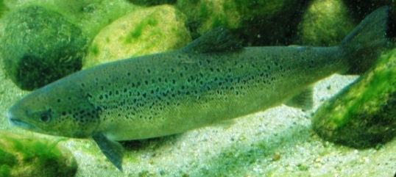
Introduction
Feed for organic aquaculture production must:
Comply with organic principles / EU regulations
Fulfil nutrient requirements, incl. specific amino acids (AA)/fatty acids (FA)
Suit specimen feeding habit
Well-balanced, to secure optimal performance, fish health, high product quality, and low environmental impact
However, EU organic regulations restrict origin
and processing of feed ingredients
2

Slide 3
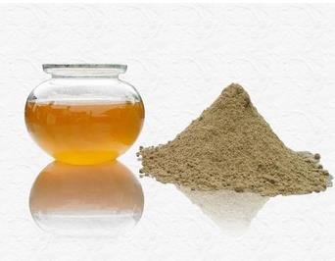
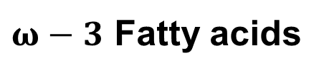
Fishmeal (FM) and Fish oil (FO)
Natural ingredients in diets for carnivorous fish and shrimps
Provides required dietary nutrients (all life stages), i.e.
- Amino acids
-
- Cholesterol & phospholipids
- Vitamins and minerals
Limited availability / restrictions
$ω−3$ Fatty acids
3

Slide 4
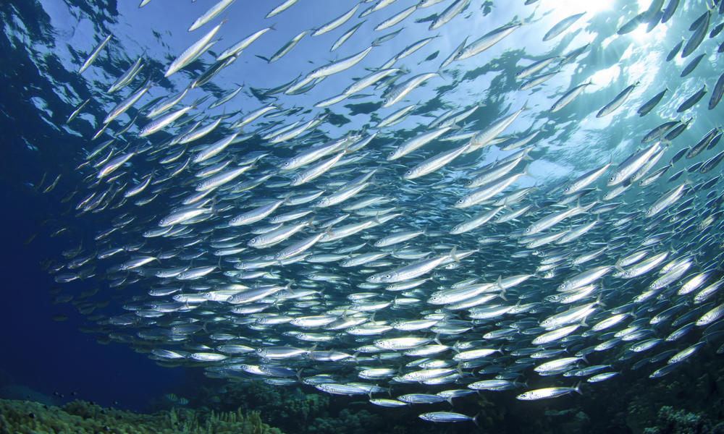
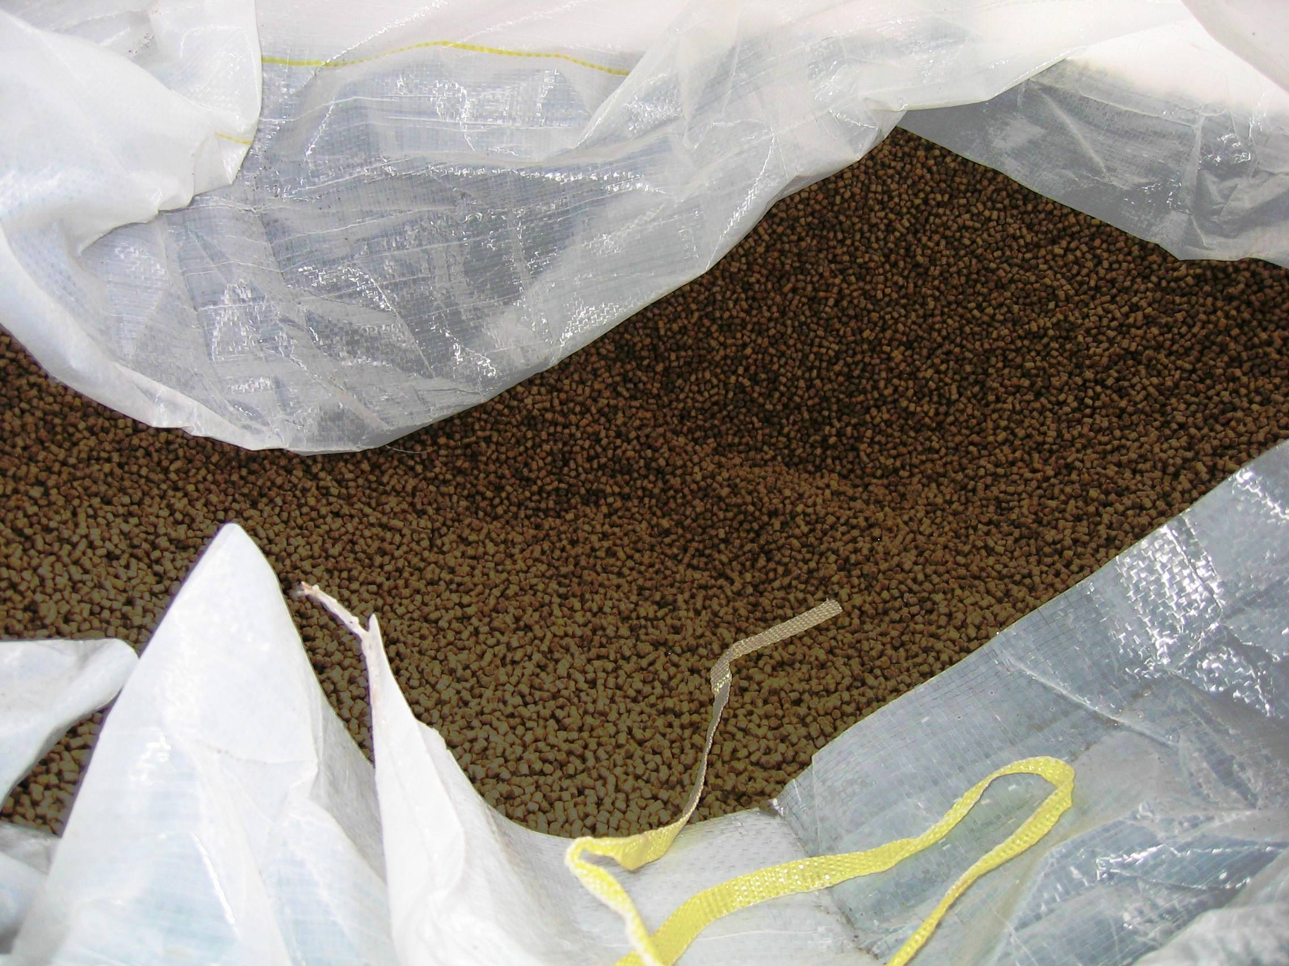
Sourcing of feed ingredients
Priority in current EU Reg. (carnivorous):
Organic feed products of aquaculture origin
Fishmeal & fish oil from organic aquaculture trimmings
Fishmeal & fish oil derived from trimmings of fish caught in sustainable fisheries
Organic feed material of plant origin (max. 60 %)
Fishmeal & fish oil derived from fish caught in certified
sustainable fisheries (Amendment Reg. 1358/2014)
4

Slide 5
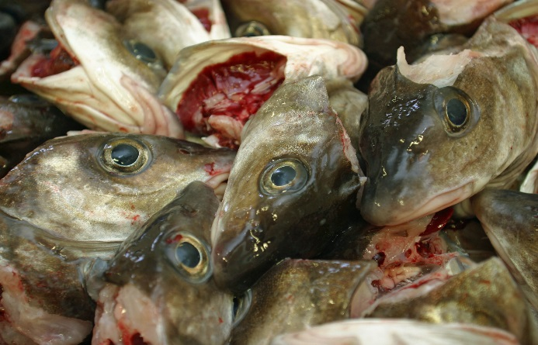
Sourcing of feed ingredients
Organic feed products of aquaculture origin
Fishmeal & fish oil from organic aquaculture trimmings
Fishmeal & fish oil derived from trimmings of fish caught in sustainable fisheries
Challenges:
Organic feed products of aquaculture origin and trimmings from organic aquaculture are only available in limited quantities
Trimmings are not a well defined product, i.e. variation in protein (AA), lipid (FA), mineral content (high P)
Trimmings can not be used in feed for the same species
5

Slide 6
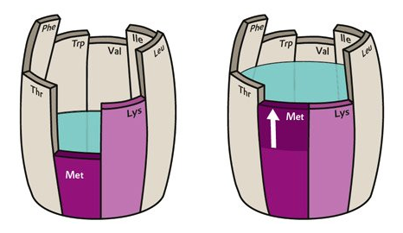
Fishmeal replacement
Organic feed material of plant origin (max. 60 %)
Challenge: Inadequate Amino Acid (AA) profile
First limiting AA determines performance
Synthetic AA not allowed
Anti-nutrients
Environmental impact
Histidine (fermentation)
may supplement salmonid diets
(Amendment Reg. 1358/2014)
6

Slide 7
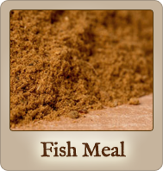
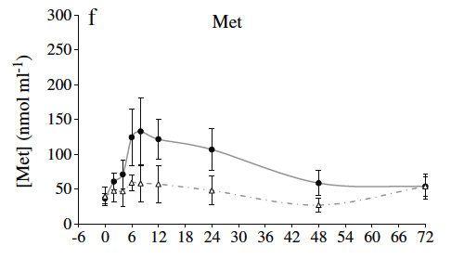
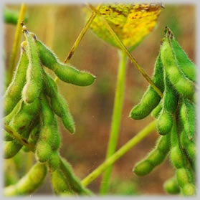
Sourcing of feed ingredients
Organic feed material of plant origin (max. 60 %)
Challenge: Differences in amino acid up-take pattern between FM and VEG based diets
FM
∆ VEG
Courtesy of Larsen et al., 2012
Time after feeding (hours)
7
By courtesy of V.J. Larsen

Slide 8
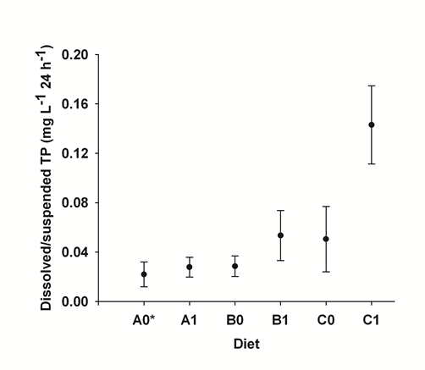
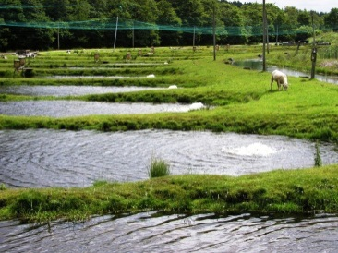
Sourcing of feed ingredients
Organic feed material of plant origin (max. 60 %)
Challenge: Limited phosphorus availability in plant ingredients
A, B,C: 0.29 % phytate-P
A: 0.89 % Total-P
B: 0.97 % Total P
C: 1.12 % Total P
Courtesy of Dalsgaard et al., 2009
8
Suffix ”1” : phytase supplement
By courtesy of V.J. Larsen

Slide 9
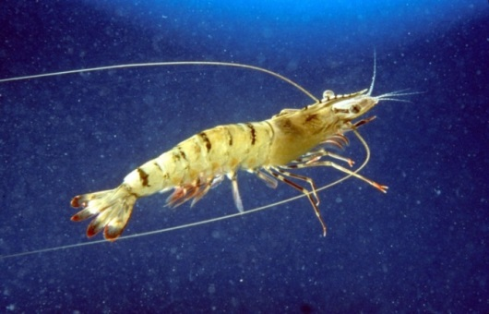
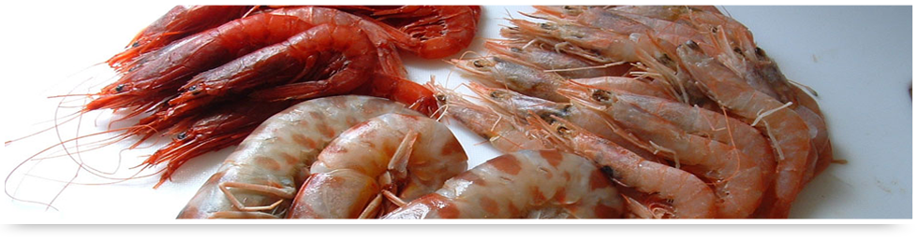
Sourcing of feed ingredients
Amendments by Reg. 1358/2014:
Fishmeal & fish oil derived from fish caught in certified
sustainable fisheries
Supplementary feed for shrimps may
comprise max. 25 % fishmeal and
10 % fish oil
Cholesterol may supplement shrimp diets
Conventional phytoplankton and zooplankton may be used as feed in larval rearing of organic juveniles
9

Slide 10
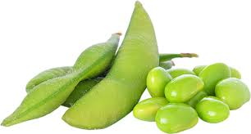
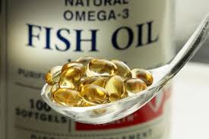
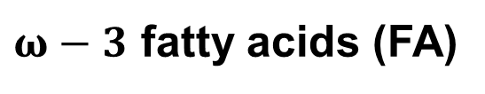
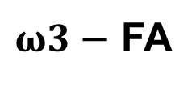
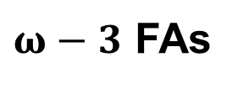
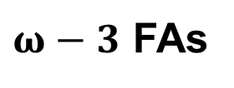
Fish oil replacement
Long chain high unsaturated are unique in fish oil/marine phyto-/zooplankton
Required in carnivorous fish diets, e.g. EPA and DHA
Plant oils contain only short chain
  Limited – if any - innate capacity in carnivorous fish for converting short chain into EPA/DHA
Strategic use of available resources
$ω−3$ fatty acids (FA)
$ω−3$ FAs
$ω−3$ FAs
$ω3−$ FA
By courtesy of ,Culmarex
10

Slide 11
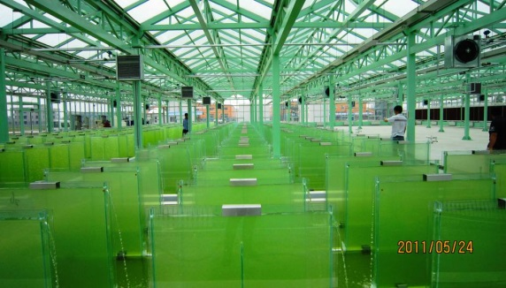
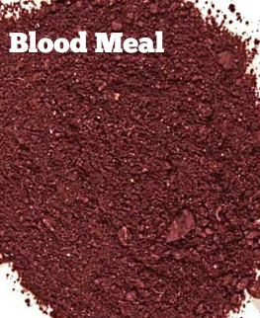
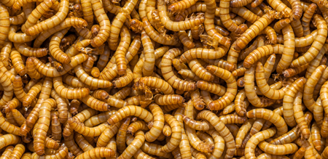
Innovative feed ingredients
Bacteria, fungi, algae
  Single cell organisms (AA profile ⸗ FM)
  Waste may be substrate ⸗
  recycling nutrients
  Marine micro algae ⸗ EPA, DHA etc.
Processed (non-ruminant) Animal Protein (PAP), blood meal
  High protein/adequate AA content
Insect meals
  High protein/adequate AA/(FA) content
  Growth substrate/feed determines composition
  High productivity
11

Slide 12
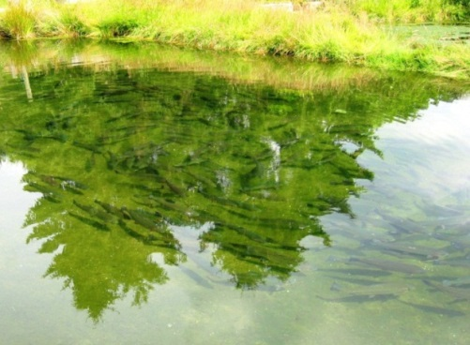

Main perspectives of organic aquaculture feed
Diversifying the basket of available feed ingredients to complement the need of optimal diets for organic production, i.e. AA, FA, etc.
Innovation in development of alternative diet sources, e.g. EPA, DHA etc.
Recycling wastes as a resource
12
By courtesy of V.J. Larsen

Slide 13
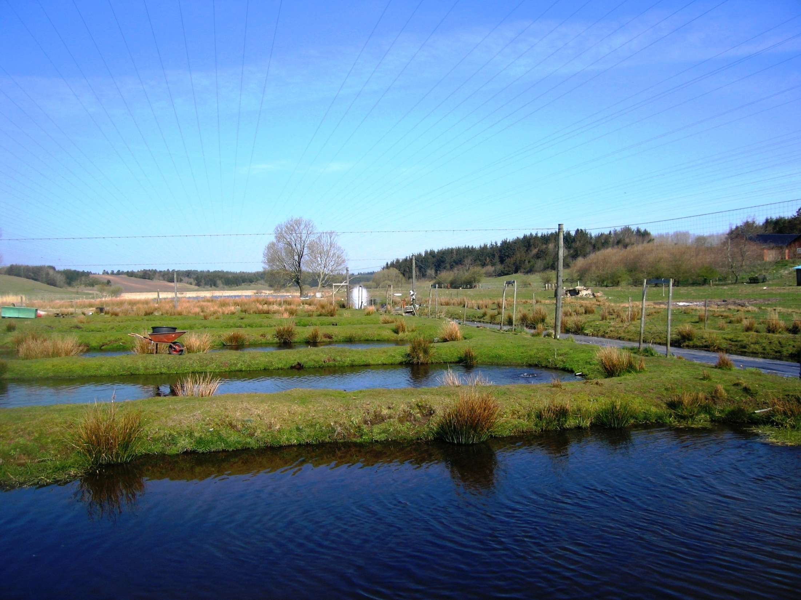


THANK YOU

