Slide 1
Possibilities and requirements for organic dairy breeding lines
M. Kargo¹⁾²⁾, L. Hjortø¹⁾, J.R. Thomasen³⁾
1) Aarhus University, Center for Quantitative Genetics and Genomics,
2) SEGES, Cattle, 3) VikingGenetics
Promilleafgiftsfonden for landbrug

Slide 2
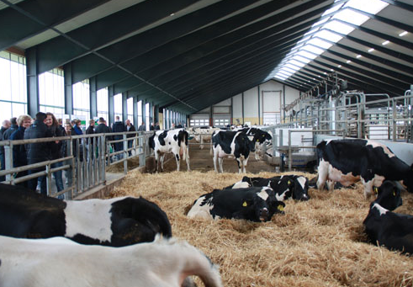
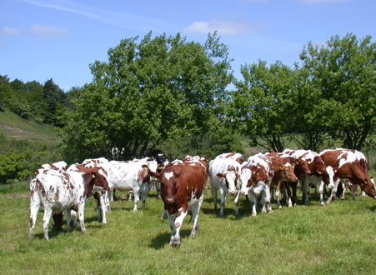
Key issue
How much can breeding goals deviate before it is relevant to split the breed in two or more lines when the breed is used for more than one purpose?

Slide 3
Current status – organic dairy breeding
Most genetic material originates from ‘conventional’ breeding schemes
Some organic farmers select sires based on customized farm indices
‘Organic’ breeding schemes have not been used on a large scale

Slide 4
Trend with customized indices
Genetic level for ‘total merit’
16 17 18 19 20 21 22 23 24 25
Birth year

Slide 5
Trend with an organic breeding scheme
Genetic level for ‘total merit’
16 17 18 19 20 21 22 23 24 25
Birth year

Slide 6
When may different breeding lines be relevant?
Climate zones
Temperate | Tropic
X | X
X | X
X | X
Conventional
Organic
High tech
Production system

Slide 7
Relative EW for Danish Holstein
across environments
Trait | Conventional | Organic | High tech
Yield | 100 | 121 | 93
Feed efficiency | 100 | 123 | 103
Cow mortality | 100 | 102 | 112
Milk fever | 100 | 338 | 202
Mastitis (infectious) | 100 | 205 | 109
Digital dermatitis | 100 | 101 | 81
Conception rate, cows | 100 | 48 | 82
Conception rate, heifers | 100 | 110 | 106
Longevity | 100 | 108 | 121
To be published soon

Slide 8
Relative EW for Danish Holstein
across environments
Trait | Conventional | Organic | High tech
Yield | 100 | 121 | 93
Feed efficiency | 100 | 123 | 103
Cow mortality | 100 | 102 | 112
Milk fever | 100 | 338 | 202
Mastitis (infectious) | 100 | 205 | 109
Digital dermatitis | 100 | 101 | 81
Conception rate, cows | 100 | 48 | 82
Conception rate, heifers | 100 | 110 | 106
Longevity | 100 | 108 | 121
To be published soon

Slide 9
Correlation between breeding goals depends on:
Economic weights
Given by production circumstances
G*E interactions
Biologically defined – cannot be changed
Registration methods
Can be harmonized

Slide 10
Breakeven correlations for line division or not
Before the genomic era
Many progeny tested bulls needed for substantial ΔG
Large populations needed
Break-even correlation appr. 0.85
Today
Cow reference populations needed
Much smaller than the number of test daughters needed before
Break-even correlation >> 0.85

Slide 11
The driving force behind genetic gain
– before GS
Registered production cows
Accuracy
Number of progeny tested young bulls
Selection intensity
Selected progeny tested bulls

Slide 12
The driving force behind genetic gain
– using GS
Production cows
Reference
population
III
Genotyped bull calves
Reference
population
II
Selection intensity
Reference
population
Selected
Genomic tested bulls
Accuracy

Slide 13
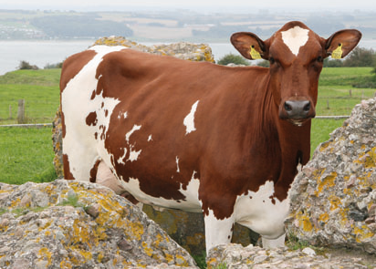
(Improved) possibilities for organic breeding lines
Genomic selection
Genetic progress in smaller population (lines of populations)
Genetic progress at a lower cost

Slide 14
Before any division we need to:
Estimate correlations between breeding goals
Derive economic weights
Estimate genetic parameters for all breeding goal traits
Estimate G*E interactions between production systems
Estimate the consequences of lines on genetic gain and inbreeding
To be investigated in SOBcows and OrganicDairyHealth

