Slide 1
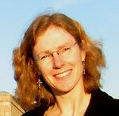
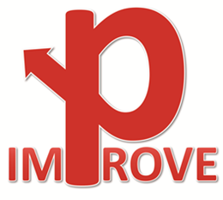
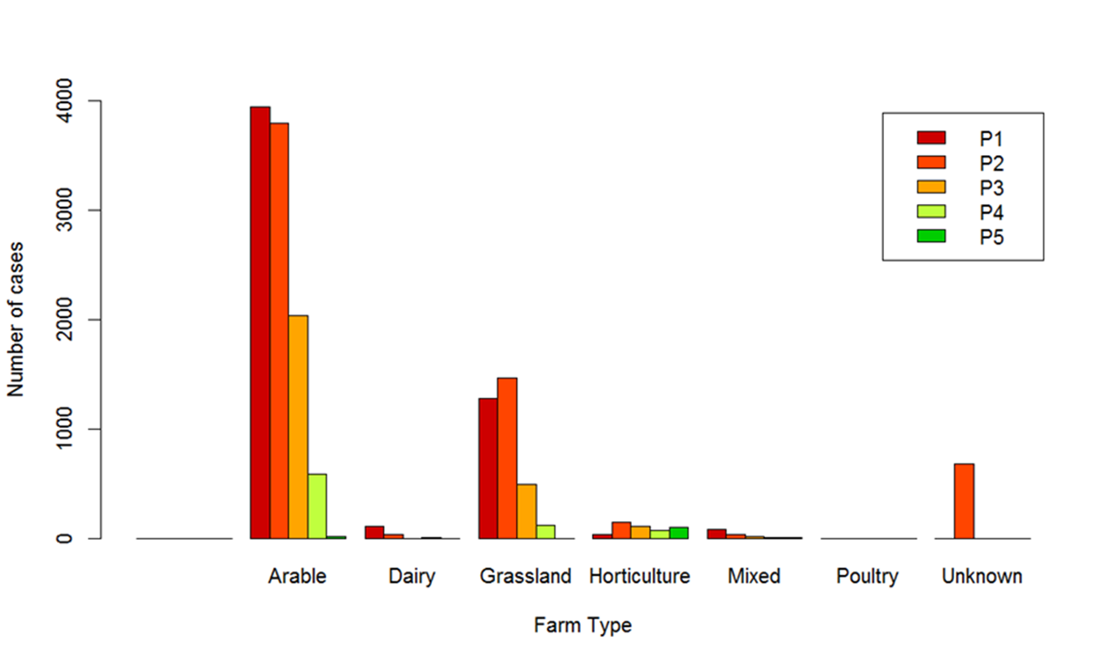
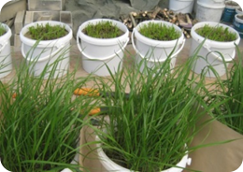
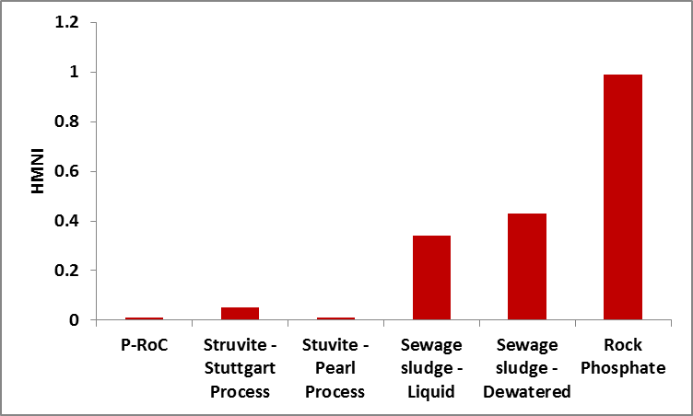
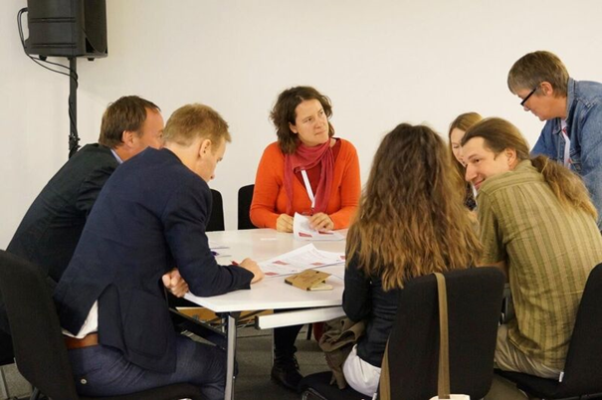
Meeting P demand in European organic farms: is it time to change the standard?
Julia Cooper, School of Agriculture, Food & Rural Development, Newcastle University, UK
Anne-Kristin Løes, Norwegian Centre for Organic Agriculture, Tingvoll, Norway
Stefan Hörtenhuber, Research Institute of Organic Agriculture (FiBL), Austria
Paul Mäder, Research Institute of Organic Agriculture (FiBL), Frick, Switzerland
Jakob Magid, Dep. of Plant and Environmental Sciences, University of Copenhagen, Denmark
Astrid Oberson, Institute of Agricultural Sciences, Group of Plant Nutrition, ETH Zürich, Switzerland
Kurt Möller, Institute of Crop Science, Fertilization and Soil Matter Dynamics, University of Hohenheim, Germany
Julia Cooper
Introduction
Results
https://improve-p.uni-hohenheim.de/
Allowable nutrient inputs in organic farming are regulated by organic standards according to core principles:
Reliance on renewable resources
Recycling of wastes & byproducts
Feeding plants through the soil ecosystem
Minimum risk of contaminants
The current list of allowable inputs excludes some potentially useful sources of P and allows others that may pose a higher risk.
In the IMPROVE-P project we investigated the need for more recycled P fertilisers (RPFs) in organic farming, studied risks associated with RPFs, and assessed stakeholder attitudes to some currently banned RPFs.
Organic farms in Europe are generally at the low end of the spectrum for P availability. Fig. 3 shows results for the whole dataset – 15,246 measured and simulated values. Low values were particularly evident in German arable farms, Austrian dairy farms and Swiss mixed farms.
Methods
Fig. 1 Pot trials used to assess P availability from RPFs
Fig. 3 Frequency distribution of soil available P values from European organic farms grouped from P1 (low) to P5 (high), by farm type
The project included.
A review of published and unpublished data on the P status of organically managed soils in Europe and distribution of soil test values into different P classes (P1=lowest P to P5=highest P) within a given farm type.
Investigation of the benefits and risks associated with using RPFs based on detailed reviews of published literature, chemical characterization of RPFs, field and pot experiments (Fig. 1) on P-availability and use efficiency of RPFs, life cycle assessments and risk analysis.
Assessment of acceptability of RPFs among key stakeholders using questionnaires at nine workshops as well as during the Organic World Congress in Istanbul, Turkey in 2014 (Fig. 2) and the international fair Biofach in Germany in 2015.
A “heavy metal nutrient index” (HMNI) was developed as a tool for comparing the risk of heavy metal contamination associated with the use of a particular RPF, relative to its potential to supply P (Möller & Schultheiß, 2014). Rock phosphate, a currently allowable P source in organic farming, actually has a higher heavy metal load per unit P, than various sewage sludge products (Fig. 4).
Results
Fig. 2 Stakeholder workshop participants at the Organic World Congress in Istanbul, discussing pros and cons of various RPFs for use in organic farming
Fig. 4 Heavy metal nutrient index (HMNI) for various fertilisers derived from human waste. Adapted from: Wollman & Möller (2015)
Conclusions
There were regional differences in attitudes towards RPFs. In the UK 70% of respondents considered sewage sludge products (e.g. biosolids) an acceptable RPF for organic farmers, in contrast to only 15% of respondents in Norway. P precipitates from wastewater were considered an acceptable RPF by 70% of all respondents.
This project broadened the debate within the organic sector on the need for RPFs and the potential of some currently banned materials to supply P. In many cases stakeholders were open-minded and receptive when discussing RPFs. In light of the current EU initiative to develop and promote a circular economy within society, the time is ripe to revisit the current EU standard on allowable inputs to organic systems.
References
Möller K. – Schultheiß U.: 2014. Organische Handelsdüngemittel im ökologischen Landbau – Charakterisierung und Empfehlungen für die Praxis. KTBL-Schrift 499. 392 pp.
Wollman I. – Möller K.: 2015. Assessment of alternative phosphorus fertilizers for organic farming: Sewage precipitation products. Research Institute for Organic Agriculture (FiBL), Switzerland.
The authors are grateful for the financial support for the project “IMproved Phosphorus Resource efficiency in Organic agriculture Via recycling and Enhanced biological mobilization” (IMPROVE-P) from the CORE Organic II funding bodies of Austria, Denmark, Germany, Great Britain, Norway and Switzerland.

