Slide 1
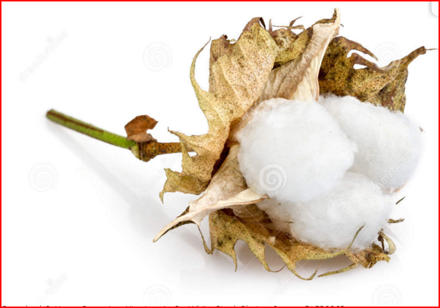
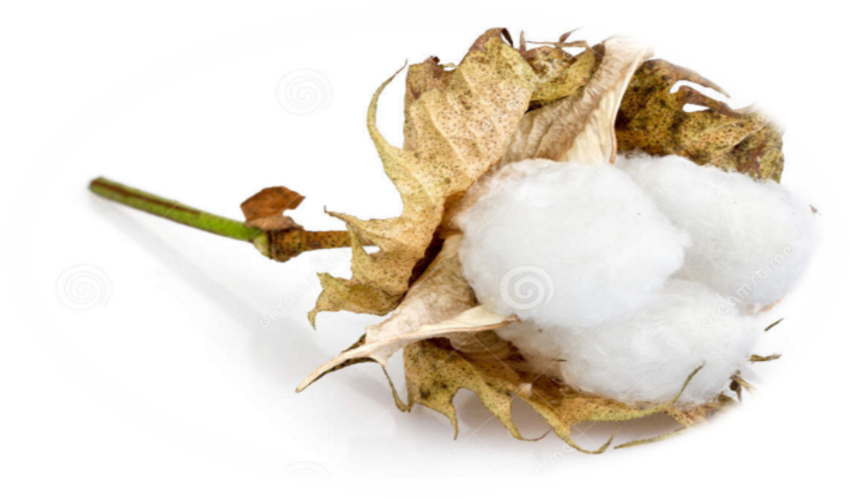
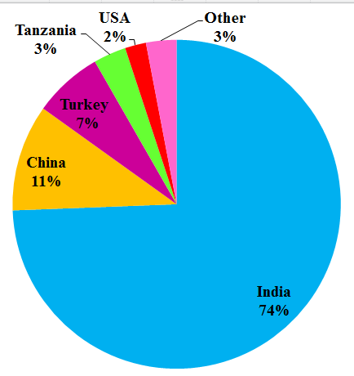
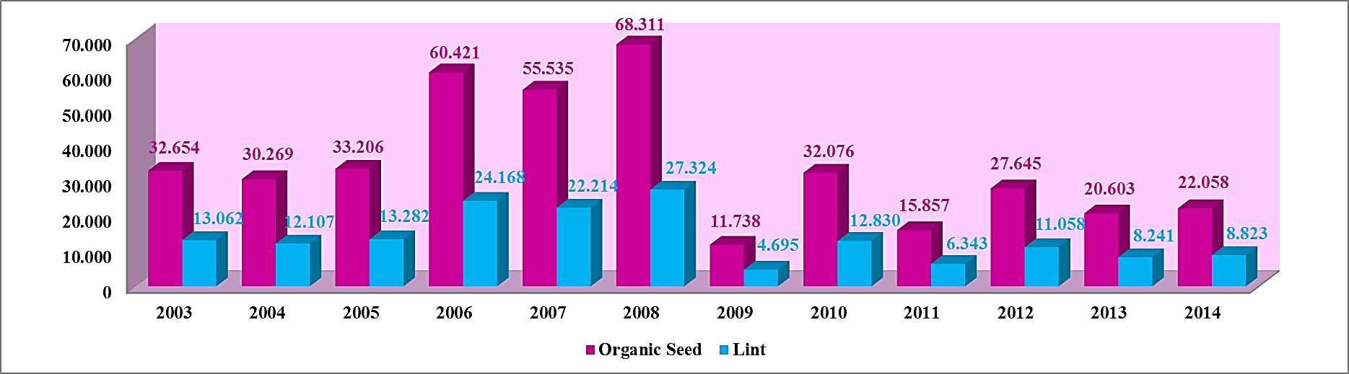
World Cotton Research Conference — 6, 02 - 06 May, 2016 Goiás, Brazil
IMPORTANCE OF ORGANIC COTTON FOR TURKEY
Ülfet ERDAL¹, Meltem BAYRAKTAR², Aynur GUREL³
¹ International Agricultural Research and Training Center, Menemen-Izmir/Turkey
² Ahi Evran University, Faculty of Engineering and Architecture, Genetic and Bioengineering Department, Kirsehir/Turkey
³ Ege University, Faculty of Engineering, Bioengineering Department, Bornova-Izmir/Turkey
Cotton production has been improved in respect to amount and quality with contributions of scientific and technological innovations. Increased sensitivity to health and environmental issues has caused development of new subjects such as organic agriculture. Organic production systems are based on specific standards that combine tradition, innovation and science. It sustains human and animal health and maintains ecosystem and soil quality. The goal of the organic cotton production system is to sustain human and animal health and maintain ecosystem and soil quality by the producing the cotton without synthetic chemical fertilizers, herbicides, insecticides, growth regulators, growth stimulators, boll openers or defoliants [1, 2, 3]. It is a consistency approach since natural fertilizer (usually from animal husbandry) and natural pesticides (Neem-based pesticides, Biosoap, Vegetable oils etc.) are used and it thus represents a circular economy in the agricultural sector [4].
INTRODUCTION
Organic Cotton Production
Sustain human and animal health
Synthetic chemicals
Fertilizers
Herbicides
Insecticides
Growth regulators
Boll openers or defoliants
Natural fertilizer Natural pesticides
Use
Avoid
Maintain ecosystem and soil quality
ORGANIC COTTON IN TURKEY
Increasing awareness about conservation of environment as well as of health hazards caused by agrochemicals has brought a major shift in consumer preference towards organic production particularly in the developed countries. Global consumers are increasingly looking for organic production that is considered safe and hazard-free [5].
The first serious attempt at organic cotton production began in Turkey in the late 1980s under the auspices of a project set up by a European cooperative of five organic food importers called the Good Food Foundation [6].
Turkey has a solid base in organic farming, and is among the leading countries in this field. Organic cotton is grown in 19 countries around the World. India, Tanzania, Uganda, China, Burkina Faso can be seen in the rank of the countries related with organic cotton production in 2014 (Fig. 1).
Table 1. Organic Seed Cotton Production in Turkey
Figure 1: Global Organic Cotton Production in 2014
Organic Seed Cotton Production (Tons)
Province | 2003 | 2004 | 2005 | 2006 | 2007 | 2008 | 2009 | 2010 | 2011 | 2012 | 2013 | 2014
Izmir | - | 1.706,40 | 1.716,00 | 253,00 | 2.315,26 | 1.730,67 | 1.088,13 | 2.068,07 | 2.326,05 | 3.388,00 | 3.196, 01 | 2254,97
Aydin | 9.841 | 6.180,85 | 5.099,90 | 6.741,55 | 12.507,09 | 6.356,33 | 646,57 | 2.598,26 | 50,00 | 2.865,00 | 2.375,93 | 3726,7451
Denizli | - | - | - | - | - | - | 232,54 | 264,86 | 1206 | 1.466,00 | 1.574,09 | 1940,45
Canakkale | 10,00 | - | - | - | - | - | - | - | - | - | -
G.Antep | 75,00 | 135,00 | 60.00 | - | - | - | - | - | - | - | -
Hatay | 572,00 | 1.060,00 | - | - | 25,60 | 70,00 | 3.025,67 | 2.497,42 | 2.216,74 | - | -
Manisa | 228,00 | 319,00 | 154,00 | 170,00 | 175,00 | 68,50 | - | 567,21 | 490,50 | 44,00 | 155,00 | 587,63
Adana | - | - | - | - | - | - | - | - | - | 176,00 | -
Sanliurfa | 21.928,00 | 19.647,40 | 25.321,10 | 52.780,00 | 39.582,12 | 57.822,28 | 6.107,87 | 22.506,05 | 8.472,22 | 21.444,00 | 13.231,62 | 13462,74
Mardin | - | 1.220,00 | 855,00 | - | 84,00 | 596,09 | 637,08 | 1.322,21 | 953,81 | 1012,00 | - | 85,98
Diyarbakir | - | - | - | 464,00 | 366,00 | - | - | - | - | 571,00 | -
Mugla | - | - | - | 12,50 | - | - | - | - | - | - | -
Adiyaman | - | - | - | - | 480,00 | 1.480,00 | - | - | 142,00 | 67,00 | 70,00
K.Maras | - | - | - | - | - | 186,83 | - | 252,10 | - | - | -
TOTAL | 32.654 | 30.268 | 33.206 | 60.421 | 55.535 | 68.310 | 11.737 | 32.076 | 15.857 | 27.645 | 20.602,65 | 22.058,22
Textile Exchange Organic Cotton Farm and Fiber Report in 2014 announced that organic cotton production 147.971 farmers, 116.974 MT fiber (1.1 million bales) grown on 258.648 hectares (1.14 million acres) in 2013-14 in the world.
Organic cotton now represents approximately % 4.4 percent of global cotton sector [1, 2, 5]. However, it is expected that the organic cotton fiber demand will exceed the supply in the future.
Until now, organic cotton was considered a niche product, but, with the effects of customer awareness, organic cotton related textile sector has begun to shift from a niche market to the mainstream [7].
Nowadays, organic cotton has been produced in 14 provinces of Turkey. Table 1 shows the production values of the provinces where organic cotton is grown in Turkey. The highest production is in Sanliurfa, followed by Izmir province in 2014. Turkey had about 8.823 tons cotton lint production in 2014. (Figure 2) [5].
Figure 2. Organic Seed Cotton and Lint Production in Turkey
REFERENCES
CONCLUSION
[1] Organic Cotton Fiber Guide. Textile Exchange 2014
[2] http://attra.ncat.org/attra-pub/organiccrop.html
[3] Erdal Ü, Gürel A (2012) Status of organic cotton production in Turkey. 11th Meeting of the Inter-Regional Cooperative Research Network on Cotton for the Mediterranean and Middle East Regions, 05-07 November, pp 6, Antalya, Turkey
[4] Wakelyn PJ, Chaudhry MR (2009) Organic cotton: production practices and post-harvest considerations. In: Blackburn RS (ed) Sustainable textiles: Life cycle and environmental impact, Woodhead Publishing Limited, India, pp 231-301
[5] http://www.tuik.gov.tr
[6] Myers, Dorothy and Sue Solton Organic cotton: from field to final product. London 1999.
[7] International Textile Manufacturers Federation Travel Report, October 23-28, 2011. Turkey.
Due to difficulties such as the marketing, contracting problems, balance of supply and demand, etc., organic cotton production in Turkey is experienced fluctuations year by year.
Turkey has many advantages such as knowledge on agriculture, textile infrastructure and environmental conditions in order to develop different kinds of organic textile products.

