Slide 1
Abstract
There is a growing health concern over obese and overweight children. Schools are a well suited setting for children for learning and adopting sound life skills. Using schools in healthy eating strategies may play an important role in preventing children from becoming obese and overweight. As a result a growing number of schools and municipalities engage in initiatives that promote healthy foods and eating. Some of these initiatives however are not focused only on healthy eating alone, but involve objectives to promote more sustainable consumption through developing organic supply chains for school food services. The question therefore arises whether these two change objectives and drivers interact. This paper investigates the interrelation between the two objectives: healthy eating and organic consumption. Can these two goals be reached in one go as previous studies indicate? Is it so that developing either of these strategies leads to a raise of awareness in school food services in such a way that the other strategy is supported at the same time? The paper investigates this possible twin ship by studying characteristics of school food services in Denmark and in Germany. In both cases delivery of school food is voluntary and thus subject to an active decision by schools. The study uses “proxies” as an indicator for healthy eating, such as availability of healthier food items, adoption of food and health issues in curricular activities etc. The study was initiated in Denmark, where a web-based questionnaire methodology was developed. The questionnaire was distributed to schools that were service, and answered by school food coordinators. As a second step the questionnaire was translated and adapted to be used in Germany. The questionnaire explored the attitudes, policies and actions in relation to organic and healthy foods served in the schools. Both Danish and German results indicate that schools with organic supply tend to be healthier when measured in terms of “proxies” for healthy eating.

Slide 2


Organic and healthy – two goals in one go?
A comparative analysis study among public primary schools in Denmark and Germany.
Chen He & Bent Egberg Mikkelsen
Food, People & Design

Slide 3
The two trajectories
Organic agenda
Obesity agenda
Organic policy (POP)
Food and nutrition policy (FNP)

Slide 4
The full WP5
WBQ in
Denmark
Italy IT survey respondent: 174 schools completed the WBQ/39 partially completed/ 1153 distributed, survey ended.
FI survey respondent: 205 completed/46 partially completed/ 999 distributed, survey ended.
DE survey respondent: 45 completed/ 61 partially completed/ 133 distributed, survey on going

Slide 5
How to measure health impact of school food the role of proxies
BMI
Dietary intake
School reports on healthy eating supportive actions
BMI of students – a proxy for health status.
Dietary intake of student – a proxy for risk of developing obesity (increased BMI),
School reports on healthy eating supportive actions - a proxy for healthy eating of students.

Slide 6
The proxies close to the real thing
Meeting nutritional guidelines?
Having a nutrition committee?.
Having a food and nutrition policy?
Availability of FV
Availability of water
Non availability of fizzy drinks
Non availability of cocoa milk

Slide 7
First draft of Q
Pilot test
First draft of Q
WBQ DK
Data DK
Ø > non Ø
Pilot test
WBQ DE
Comparative analysis
Data DE
Ø > non Ø
Flow sheet of survey. The figure shows the steps in the survey process in Denmark and Germany. Legend: Ø= Organic, non Ø = conventional.

Slide 8
Survey key figures.
Status of distribution and respondence of WBQ.
 | Denmark | Germany
Distributed | 179 | around 1050
Partially completed | 13 | 57
Completed | 79 | 34
No respondence | 87 | around 959

Slide 9
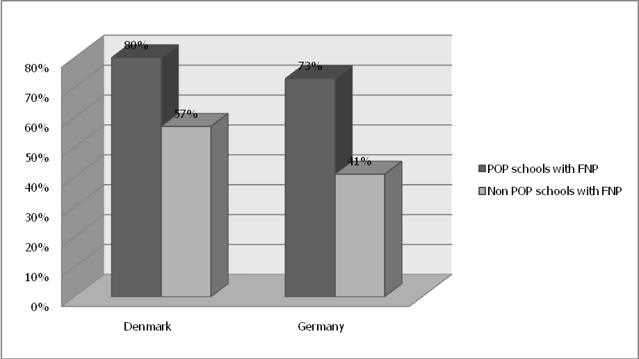
Having a food and nutrition policy? Percentage of POP and non POP schools that have adopted a FNP

Slide 10
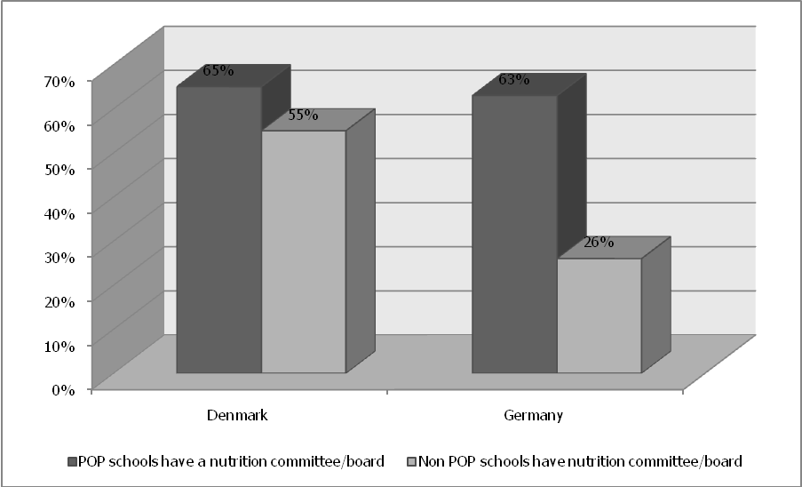
Having a nutrition committee?. Percentage of POP/non POP schools that have a nutrition committee or board regarding pupils’ health and nutrition aspects.

Slide 11
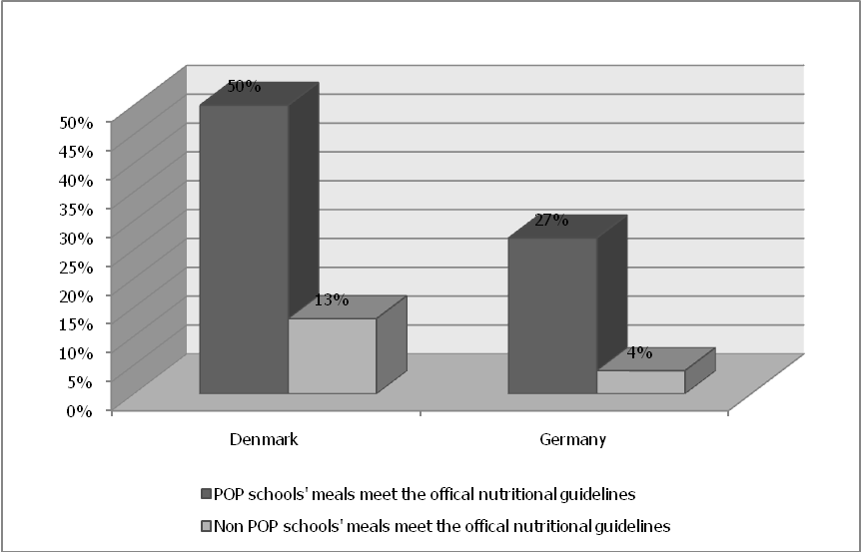
Meeting nutritional guidelines? Percentage of POP/non POP schools that meet the official nutritional guidelines for school meals.

Slide 12
A possible explanation
Municipality
Head master
Head teacher
Dinner lady
Students

Slide 13
A possible explanation
Municipal civil servants write the operational procedures
School head master initiate a meeting on school food
School head master receives a letter
Positive lists and negative lists are discussed
Dissussions go on about the shape of school food
Municipal council adopts and agenda 21 policy
Organic food issues debated
Health issues debated
Menus taken to redesign
Increased awareness
More vegetables, less meat.

Slide 14
Recommendations
There is ample evidence that consumers in most cases make a link between organic food and individual health
Some evidence on the fact that organic supply associates with healthier options
Think in terms of radical menu redesign. Replacement or substitution won´t lad anywhere
Consider to let you food and nutrition policy include also a position on organic food
Organic food supply should not stand alone. Apply the whole school approach and integrate it in the curricula as well
Integrate theoretical teaching with hands on learning

Slide 15


Thank you for your attention
And to co-workers
Chen He
Melanie Lukas
Carrola Strassner
Roberto Spigarolo
Minna Mikkola

